Slide 1
CHEM 570, Fall 2017
Concepts in Chemical Biology
Lecture 10
High-throughput compound screening

Slide 2

High-throughput screening (HTS)
Goal: find the needle (i.e., compound) in the haystack
Assumption:
More compounds screened → better chances of “hit”
In vitro
screens
Cell-based
screens

Slide 3
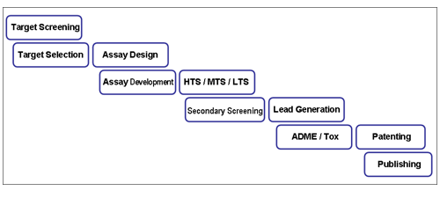
High-throughput screening process
Three-step process:
(1) Assay design, development, and validation
(proteins/cells, controls, etc.)
(2) Screening
(compounds, logistics, etc.)
(3) Validation of hits
(testing individual hits in other assays)
ADME: adsorption, distribution, metabolism, and excretion
http://research.med.helsinki.fi/corefacilities/htc/

Slide 4
In vitro screening: assay development
For an in vitro assay, compounds are tested against a particular target outside the cellular environment
• Enzyme inhibition
• Protein binding
• RNA binding
• DNA binding
• others
Benefits:
• Can easily assess whether compound-target interaction
• Results typically straightforward to interpret
Challenges:
• Complicated assay development
• Production of pure protein, RNA, or DNA
• Will the compound then work in cells, animals...?

Slide 5
Enzyme inhibition assay
Enzyme inhibition assay: most common in vitro screen
What is different about reactants versus products?
A
B
+
C
Ideal is a gain of signal assay:
quantitate formation of B or C
A
B
+
C
But a loss of signal assay is also useful:
quantitate disappearance of A
A
B
+
C

Slide 6
Enzyme inhibition assay: substrates
Ideally, the natural enzyme substrate would be used:
However, commonly a modified substrate is used
→ colorimetric or fluorescent assay
p-nitrophenolate anion
(intense yellow absorbance;
λ_{max} 405 nm)
Hergenrother & Martin, Topics Curr. Chem. 2000, 211, 131

Slide 7
Enzyme inhibition assay: substrates
Natural enzyme substrate:
β-lactamase
Modified substrate:
decrease in absorbance (A₂₆₅) upon hydrolysis
Tondi et al., Chem. Biol. 2001, 8, 593

Slide 8
Chromogenic and fluorescent products
Certain compounds are chromogenic or fluorescent
once they are released
p-nitrophenolate
X-gal
7-amino-4-trifluoromethyl-
coumarin (AFC)
chromogenic
chromogenic
fluorescent

Slide 9
Gain of signal assay
PARG
ARH3
ADP-ribose
ADP-ribose
Hergenrother lab

Slide 10
Loss-of-signal assays
Sometimes it is impractical to quantitate the products,
or it is easier to monitor disappearance of reactants
Can we distinguish chemically between these two nitrogens?

Slide 11
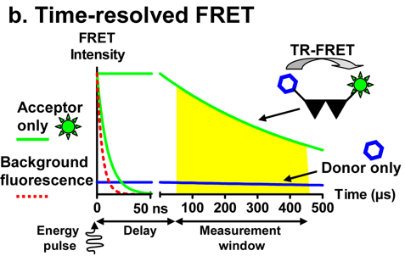
Time-Resolved FRET assay
If you do not have reporter substrates for your enzyme…
Advantage: Better S/N ratio
Need fluorophore with long life time:
Eu or other lanthanides are used

Slide 12
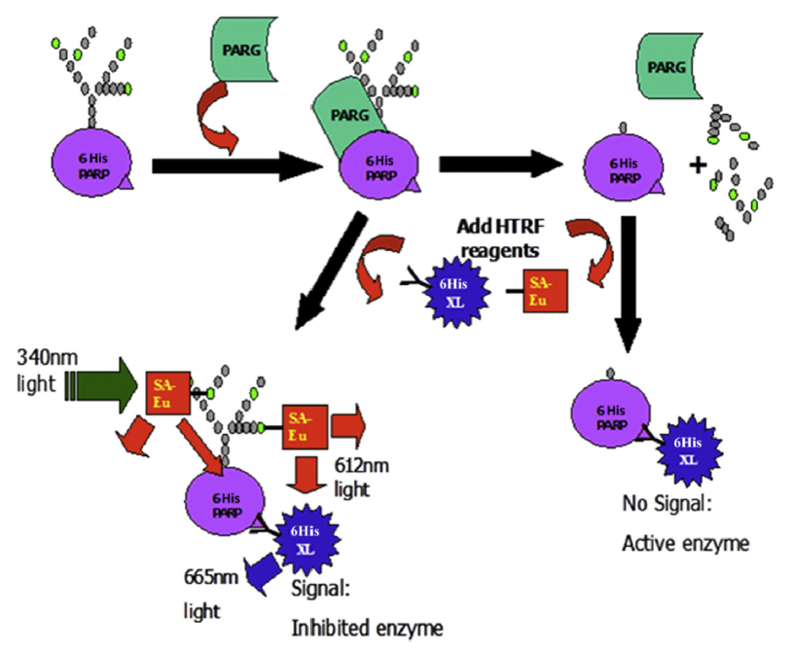
Time-Resolved FRET: Example
Biotinylated PAR (polymer chain)
Donor: Streptoavidin-Europium
Acceptor: Anti-His Ab-XLL665
PARP --polymerizes PAR chain
PARG --cleaves PAR chain
J Anal Biochem. 2016, 503, 58-62

Slide 13
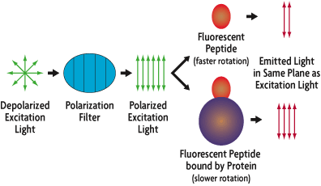
What if there is no enzymatic readout?
E.g., assay for compounds that bind to specific protein
Fluorescence polarization assay
Release of fluorescent moiety from large binding partner
→ more depolarization
(control)
Degterev et al., Nat. Cell Biol. 2001, 3, 173

Slide 14
Small-molecule microarrays
What if there is no known ligand for protein of interest?
Compounds attached to glass slides
Protein
Protein binds to target
Fluorescence reveals binding

Slide 15

Small-molecule microarrays
HF•py, then DMF
Split-pool combinatorial
library on polystyrene beads
384-well stock plate containing
small molecules in 10 µL DMF
Spot 1 nL drops
on glass slides
Probe slides with proteins;
Visualize protein-ligand
binding with fluorescence
Fluorescent spots reveal
binding interactions
10,000 small molecules per slide
A method to rapidly detect protein-ligand binding

Slide 16
Attachment of compounds to slides
thiols
alcohols, phenols, carboxylic acids
hydroxylamines, hydrazines, 1,2-aminothiols
Proof-of-concept experiments use known interactions between various small molecules and proteins
Small molecule
Protein
K_{d}
biotin
streptavidin
0.00001 nM
(10 fM)
digoxigenin
DI-22 antibody
1 nM
FK506
FKBP12
10 nM

Slide 17
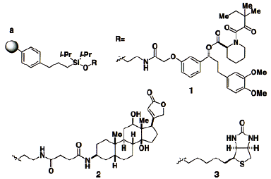

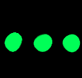
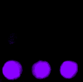
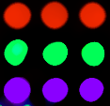
Attachment of compounds to slides: Alcohols
Compounds spotted in 1 nL drops onto glass slides:
1 1 1
2 2 2
3 3 3
400 µm
Probe with Cy5-FKBP12
Probe with Cy3-DI-22
Probe with FITC-streptavidin
Probe with all three
Hergenrother et al., J. Am. Chem. Soc. 2000, 122, 7849

Slide 18
Summary of proof-of-concept experiments
1. Attachment of compounds to slides
• Hydroxylamines and hydrazines
• Thiols
• Alcohols
• Phenols and carboxylic acids
readily available from linkers used in combinatorial chemistry
2. Probing microarrays with proteins
• Protein solutions as low as 5 nM
• Small-molecule solutions as low as 15 µM
3. Detection of protein-ligand interactions
• Direct detection with fluorescently labeled protein
• Indirect detection with antibody
Microarrays are stable for >2 months in storage

Slide 19
Examples of microarrayed compounds
3780 compounds
~4500 compounds
Kuruvilla et al., Nature 2002, 416, 653
~4500 compounds
6336 compounds

Slide 20
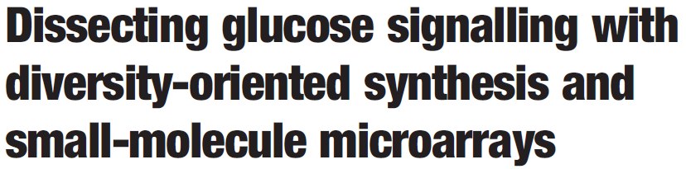
Example of microarray application: Ure2p
Ure2p
Cy5-NHS ester
“uretupamine”
Cy5-Ure2p
Slide probed with
50 nM Cy5-labeled Ure2p
Microarray of 3780 compounds
Kuruvilla et al., Nature 2002, 416, 653

Slide 21

HTS: Compounds
Once an assay is developed, then
it needs to be implemented on a large scale.
Where to get compounds from?
Synthetic chemistry & combinatorial chemistry!
The National Cancer Institute (NCI) will ship
~2100 compounds to interested users for free
Larger collections must be purchased from vendors
(e.g., Maybridge, Chembridge; Slide 9-18).
Prices range from $0.6–$4.0 per compound,
typically for ~1–2 μmol of material (~0.5–1 mg).
Hergenrother, Curr. Opin. Chem. Biol. 2006, 10, 213

Slide 22
HTS: Compounds
It is also possible to have someone else run your assay
for you, using their compound collection!
Free!
$$$
Compound
collections
(for screening
by users)
NCI
Commercial vendors
HTS
(performed by others)
**NIH-SMR/
NIH-MLSCN
Academic centers;
Commercial services
** NIH Small Molecule Repository (SMR):
http://mli.nih.gov/mli/secondary-menu/mlscn/ml-small-molecule-repository/overview/
NIH Molecular Libraries Screening Centers Network (MLSCN):
http://mli.nih.gov/mli/secondary-menu/mlscn/
Hergenrother, Curr. Opin. Chem. Biol. 2006, 10, 213

Slide 23
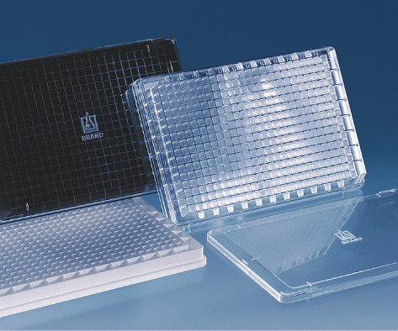
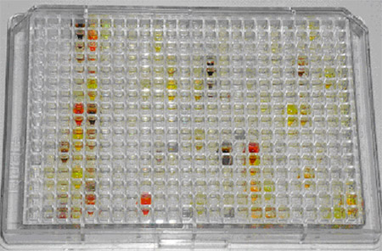
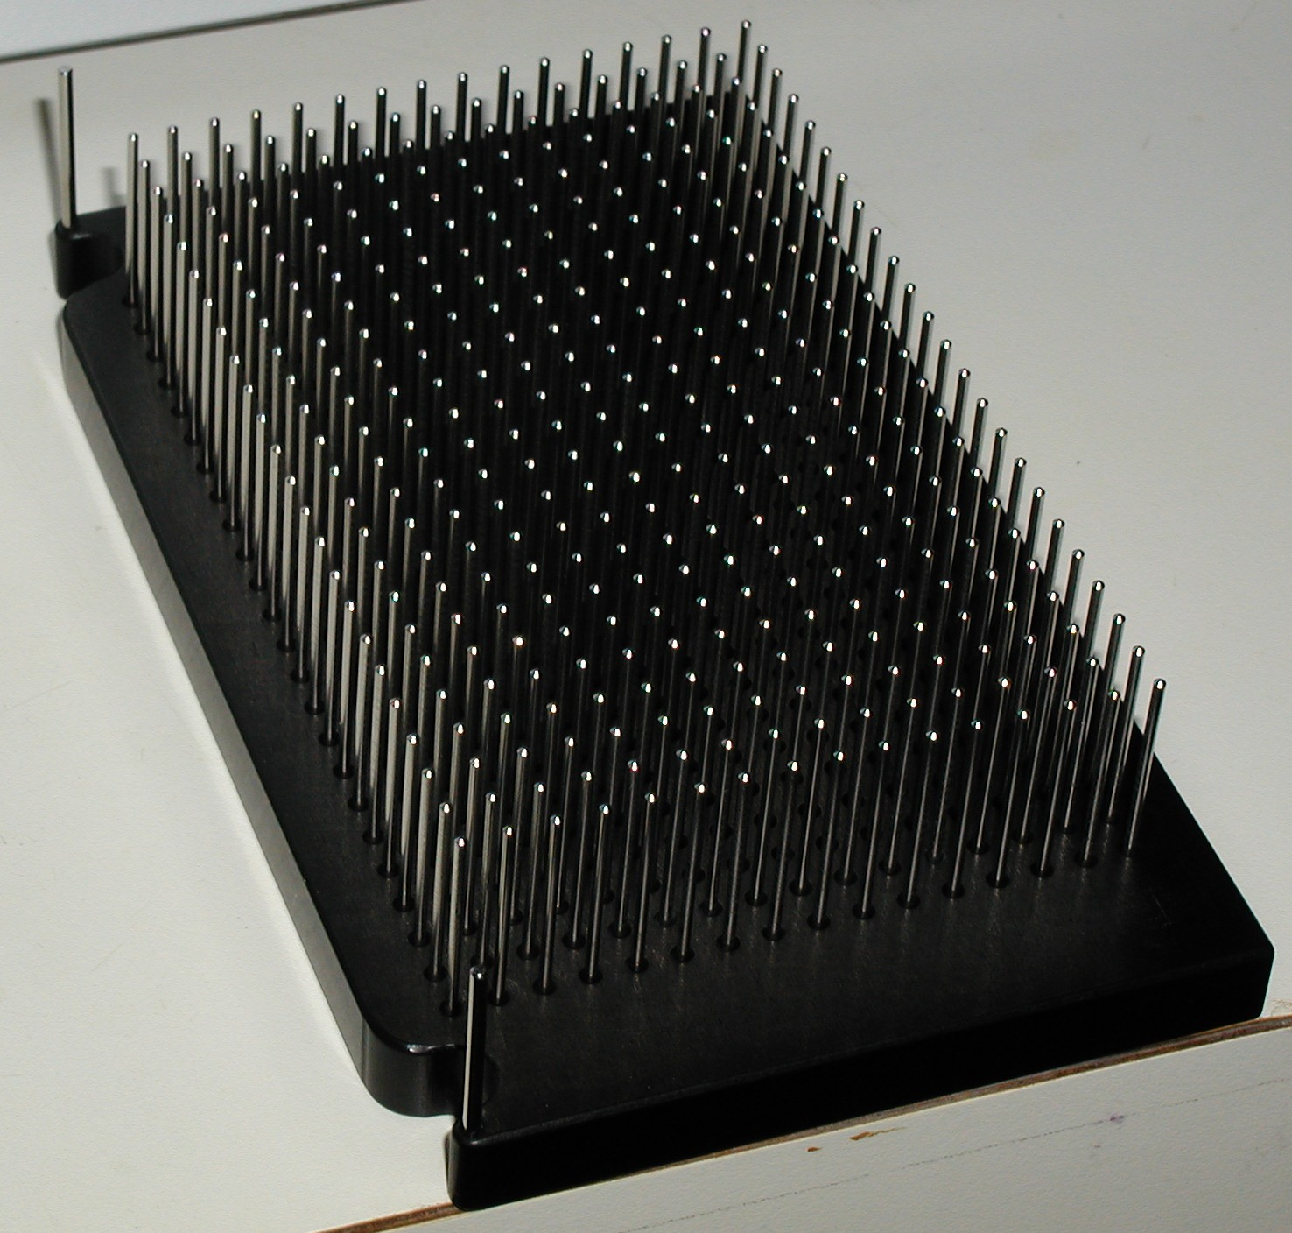
HTS: How does it work?
Compounds are transferred from master plate
(usually 10 mM solutions in DMSO) to assay plate
pin transfer
Compound stock plate
(master plate)
Assay plate
Quality control is essential!

Slide 24
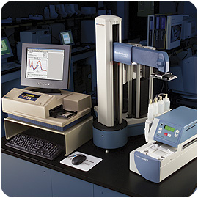


High-throughput screening at Illinois
361 Noyes Lab: 180,000+ compounds
Integrated liquid handler/plate reader
• UV/vis absorbance
• Fluorescence intensity
• Fluorescence polarization
• Time-resolved FRET
• Luminescence
Web interface for data analysis and refinement
http://www.scs.illinois.edu/htsf/

Slide 25
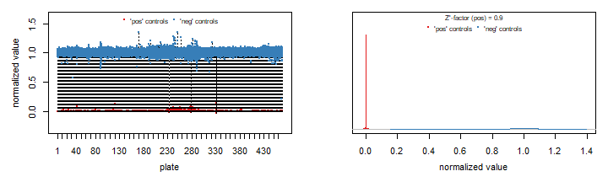
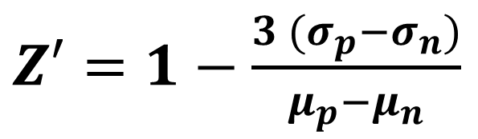
Assessment of HTS
$Z′=$ $1−\frac{3 (σ_{p}−σ_{n})}{μ_{p}−μ_{n}}$
Z’ factor: separation of controls
0.5 < Z’ < 1
Example from ARH3i HTS
Negative control Positive control

Slide 26
HTS: Criteria for a “hit”
Ideally, the bar is set high to call a compound a “hit”.
100,000 compounds screened × 0.1% hits
= 100 hits
Before a “hit” compound is accepted as real, one should:
• Confirm dose-dependent effect
• Test hit compound in independent assays
• Rule out nonspecific inhibition
Be aware of PAINS compound!

Slide 27
PAINS
Pan-Assay INterference CompoundS
Many “hits” are frequent hitters = promiscuous
16 substructural filter has been established
J. Med. Chem. 2010, 53, 2719-2740

Slide 28
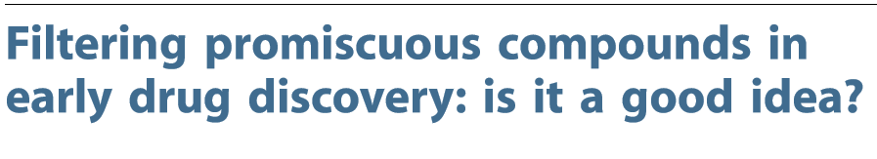
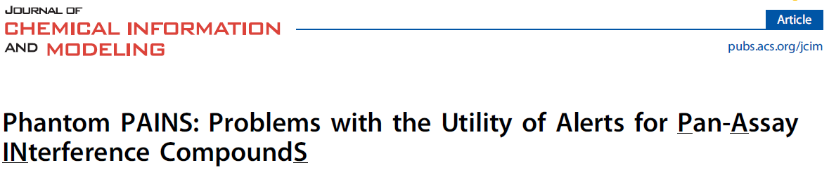
PAINS filter: is it a good idea?
87 FDA-approved drugs would be considered as PAINS compound
PAC1
Procaspase-3 activator
Idarubicin
antineoplastic
Indomethacin
COX1 inhibitor
Drug Discov. Today 2016, 21, 868-872
J. Chem. Info. Model. 2017, 57, 417-427

Slide 29
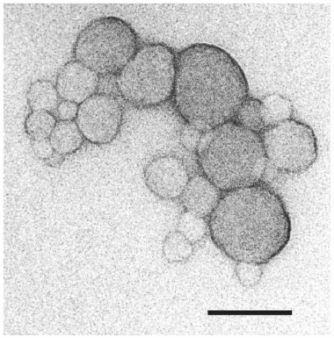
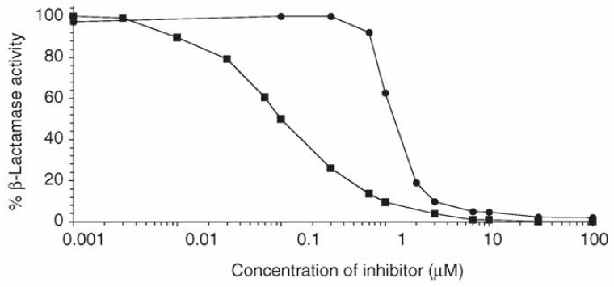
Widely accepted PAINS: Aggregators
CAUTION! Your putative “hit” compounds could be
aggregating and causing nonspecific inhibition
promiscuous inhibitor
(steep dose dependence curve)
standard inhibitor
(TEM image)
100 nm
Must validate your compounds
Use detergents (Triton-X, BSA, Tween-20, etc)
Test compounds against β-lactamase and other enzyme activity for non-specific inhibition
Shoichet, J. Med. Chem 2015, 58, 7076-7087

Slide 30
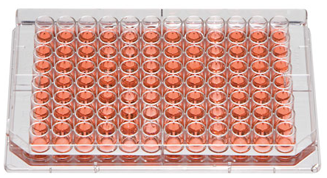
Cell-based screening
For a cell-based assay, compounds are tested
using living cells
SAR, lead optimization
Novel Target
Target identification
Novel MOA
Compounds in native biological environment
Cytotoxicity readout
Does the compound kill the cell?
Gene expression readout
Does the compound induce the gene expression of interest?
Complex Phenotype
Whole-cell immunodetection (cytoblot) assay
Mayer et al.,
Science 1999,
286, 971

Slide 31

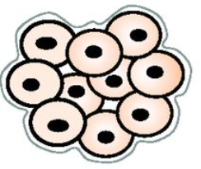
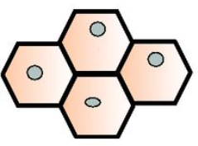
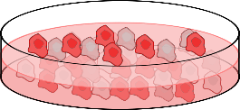
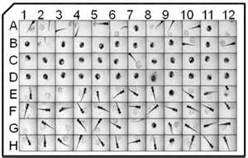
Phenotypic Screening
In modern phenotypic screening, more disease-relevant assay systems are employed
Human primary cells
Induced Pluripotent stem cells
Zebrafish!
Nat. Rev. Drug Discov. 2017, 16, 531--543

Slide 32
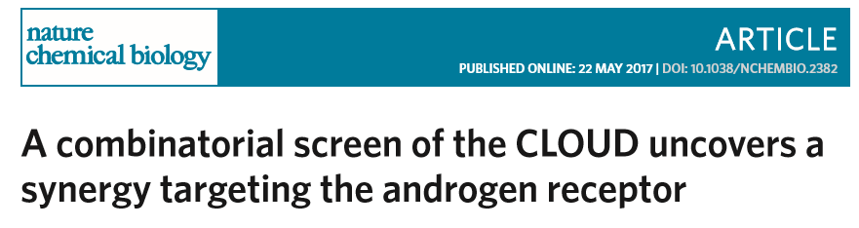

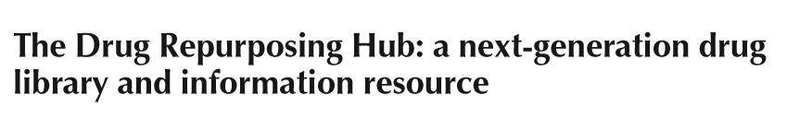
Screening already-approved compounds for other applications
Combinatorial screen
Drug repurposing
Nat. Medicine 2017, 23, 405-408
Nat. Chem. Biol. 2017, 13, 771-778
Notes:
Also relevant: Wadman-Nat-2012-490-15 (can also show at end of Lect 17 on anti-cancer compounds)

