Slide 1
CHEM 570, Fall 2017
Concepts in Chemical Biology
Lecture 1
Biochemical Basics

Slide 2
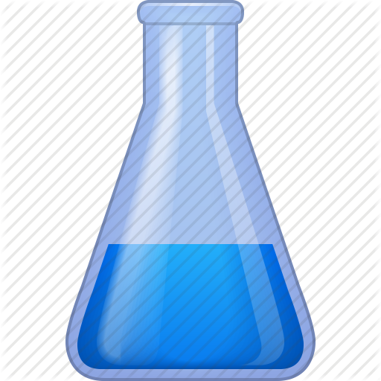
What is Chemical Biology?
Biology
inspires development of new chemical tools
Chemistry
brings new insight to biological questions
A discipline that involves the application of chemical techniques, tools, and analyses, and often compounds produced through synthetic chemistry, to study and manipulate biological systems.

Slide 3
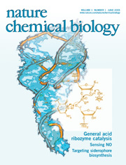
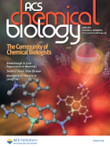
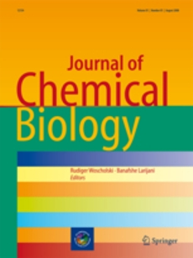
Chemical Biology in the Literature
Chemical biology papers can be regularly found in journals such as Science, Nature, PNAS, JACS etc etc…
There are also journals dedicated to chemical biology

Slide 4
Specific Aims for CHEM 570
Be familiar with fundamental chemical biology techniques
Be able to read and understand literature in this field with ease
Be equipped with knowledge to look at a scientific problem from both a chemical and biological perspective
Example: You discover a new protein! How do you isolate this protein in appreciable amounts? Characterize it? Determine its function? Elucidate its structure? Probe which amino acid residues are important for function? Determine crosstalk with other proteins or substrates? How do you selectivity inhibit or turn-on its activity?

Slide 5
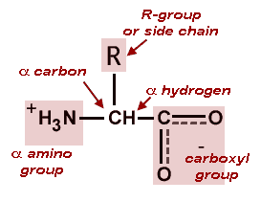
Amino Acid Basics
The L-enantiomer is utilized for all ribosomally encoded
amino acids.
20 “standard” amino acids are ribosomally encoded.
Other amino acids exist in proteins, typically via
post-translational modifications.
Two other amino acids can be encoded by
ribosomes in very rare cases (as discussed later).

Slide 6
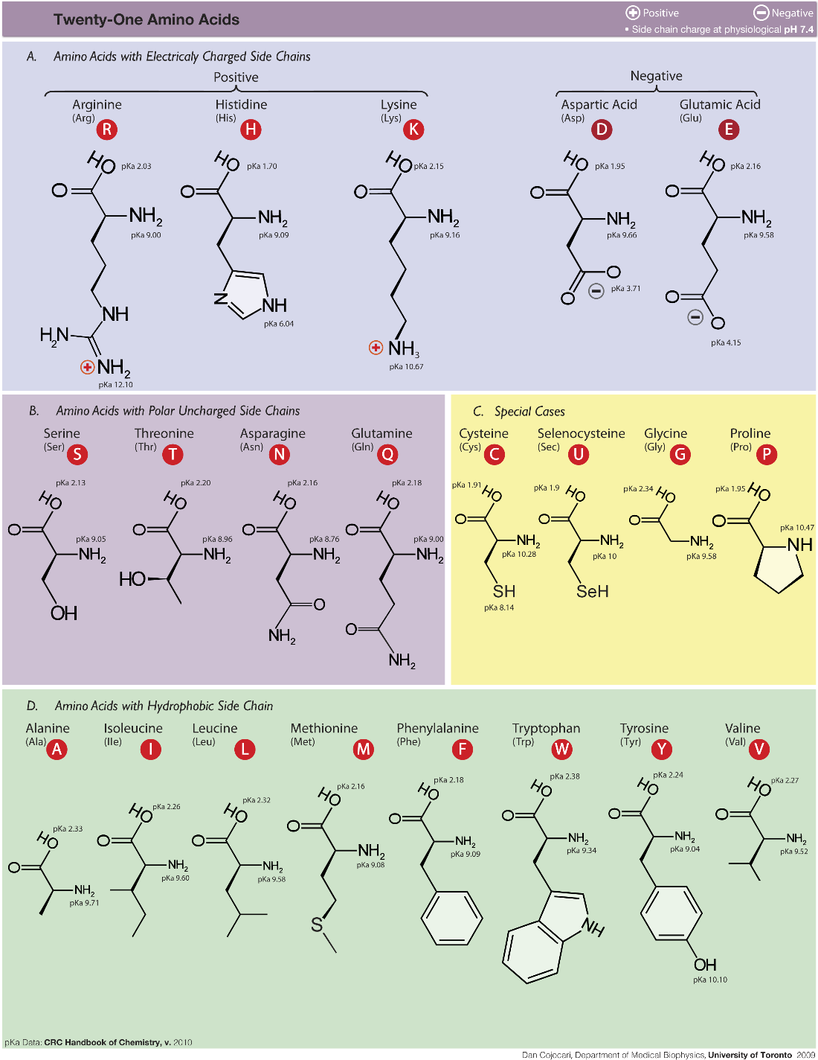
Amino Acid Basics

Slide 7
pK_{a} values
pK_{a} = the pH value at which a functional group is 50% protonated, 50% unprotonated
pH = 1.0
pH = 7.0
pH = 11.0
pK_{a} = 9.8
pK_{a} = 2.4

Slide 8
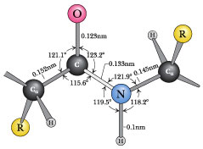
The peptide bond
amino
acid 1
amino
acid 2
dipeptide
Carbonyl oxygen
and amide hydrogen
are trans

Slide 9
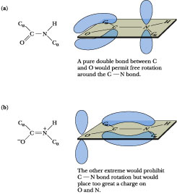
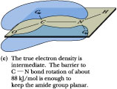
The peptide bond has double-bond character

Slide 10
Diversity in protein function
Enzymes Receptors Antibodies
Hormones Regulatory Storage
Structural Protective ...?
A protein of 100 aa has 20¹⁰⁰ ≈ 10¹³⁰ possible sequences! (2¹⁰ ≈ 10³)
An average 100 aa protein has a mass of 11,000 daltons; thus,
10¹³⁰ such molecules would have a mass of 1.4 x 10¹³⁴ daltons.
The mass of the universe is ~10⁸⁰ daltons.
Thus, the universe lacks enough matter to make just one molecule of each possible aa sequence for proteins only 100 residues long.

Slide 11
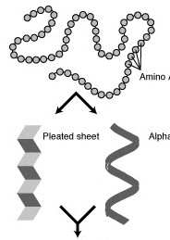
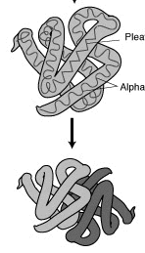
Protein structure
Primary, secondary, tertiary, quaternary
Primary
amino
acids
Tertiary
β-sheet
α-helix
Secondary
Quaternary

Slide 12
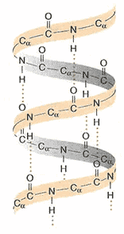
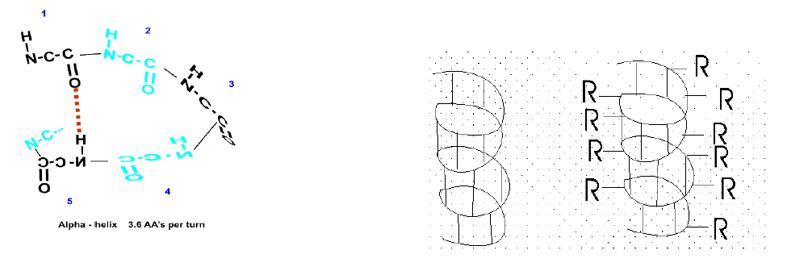
Secondary (2°) structure – alpha-helix
The α-helix is a rod-like structure. Hydrogen bonds between the N–H and the C=O groups of the backbone link the peptide bonds between every fourth amino acid.
Right-handed α-helix (coils clockwise) 3.6 residues per turn All C=O and N–H groups are H-bonded Sidechains (R) point outward H-bonds form between N–H and C=O of every fourth amino acid in the chain (i, i+4)

Slide 13
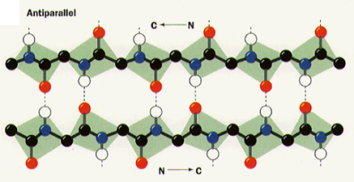
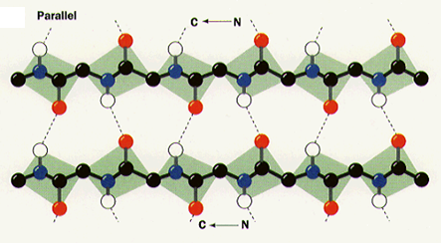
Secondary (2°) structure – beta-sheet
β-sheets are also held together by hydrogen bonds between the N–H and C=O groups of the peptide bonds.
A polypeptide in a β-sheet is called a β-strand. It is almost fully extended (uncoiled), with 3.5 Å between adjacent residues.
The β-sheet is stabilized by H-bonds between the N–H and the C=O groups of different peptides or different parts of the same peptide. The β-strands in a sheet can either run in the same direction (parallel) or in different directions (antiparallel).

Slide 14
Tertiary (3°) structure
Overall 3D structure of protein;
describes how the peptide chains fold and pack
At least 4 considerations dictate 3D protein structure:
1. Hydrophobic interactions
2. Hydrogen bonds
3. Ion pairs (salt bridges)
4. Disulfide bonds
Notes:
Also cation-pi effects

Slide 15
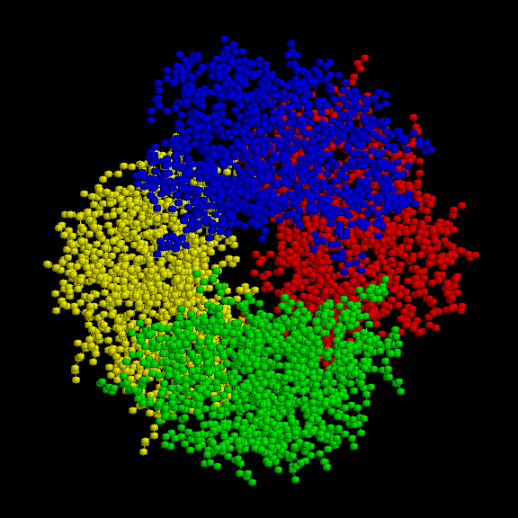
Quaternary (4°) structure
Refers to arrangement of multi-subunit proteins
Requires more than one polypeptide chain:
hemoglobin
Conditions of high salt, denaturant, high/low pH, etc.
cause dissociation of the protein complex into monomers

Slide 16
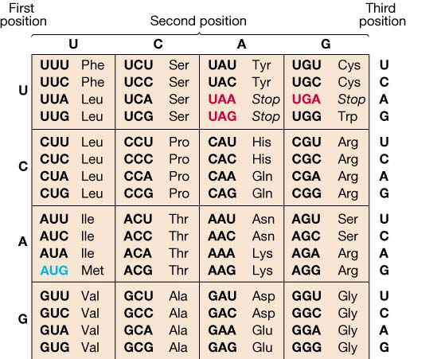
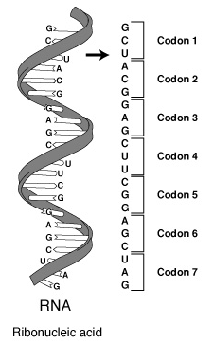
Protein synthesis = translation
A codon (triplet of bases) specifies a given amino acid
The Genetic Code:
64 codons for 20 amino acids

Slide 17
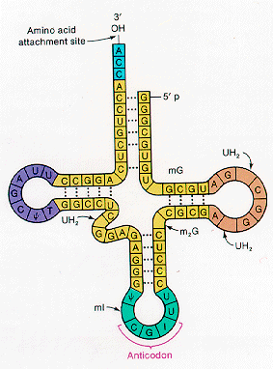
Conversion of codons to proteins via tRNA
Structure of a tRNA:
Aminoacyl tRNA synthetase
catalyzes the attachment
between tRNA and amino acids
Anticodon loop is matched
by ribosome to proper
mRNA codon
Notes:
Please be sure you can draw the tRNA attached to an amino acid; i.e., an aminoacyl-tRNA.

Slide 18
Translation is performed by the ribosome
Initiation, Elongation, Termination
Prokaryotic
Ribosome:
70S
50S and 30S
5S, 23S,
32 polypeptides
16S, 21 polypeptides
16S rRNA recognizes the Shine-Dalgarno sequence
(RBS, ribosome binding site), which is
5–10 bp upstream of the AUG start codon
S-D sequence
start codon
5’-…AGGAGGUXXXXXXXAUG...3’
bacterial mRNA
3’-…UCCUCCA…-5’
16S rRNA
anti-S-D sequence

Slide 19
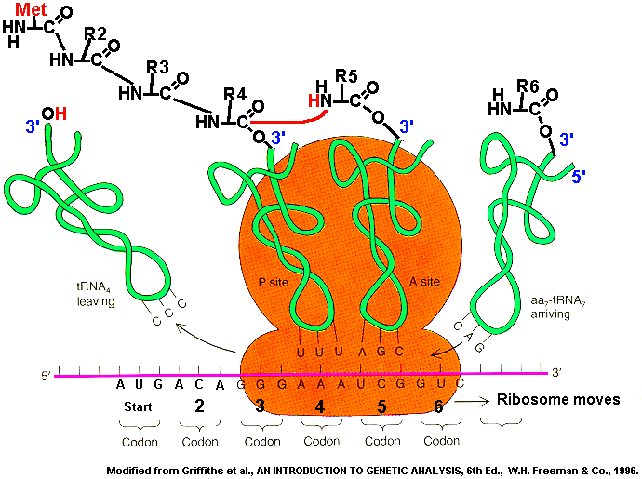
Translation is performed by the ribosome
The ribosome is a large complex of both protein and rRNA
Prokaryotes – translation occurs on growing mRNA
Eukaryotes – translation typically occurs after mRNA processing and export to the cytoplasm

Slide 20
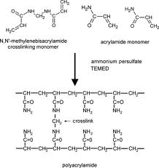
Biochemical analysis of proteins (and DNA)
Gel electrophoresis – separation and visualization
• An electric current moves proteins and DNA
through a matrix, typically polyacrylamide or agarose
• Gels: sponge-like, with different pore sizes depending
on the concentrations of materials used to form them
Molecules are separated based on size; allows for semi-quantitative assessment of purity

Slide 21
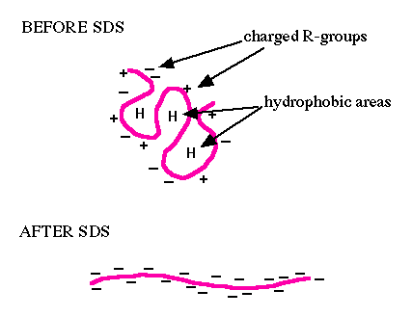
Biochemical analysis of proteins
• Typically by polyacrylamide gel electrophoresis (PAGE)
• Sodium dodecyl sulfate (SDS) is added to denature
the proteins and add negative charges in proportion
to the protein mass (SDS-PAGE)
• If SDS is not added, then the gel is termed a “native” gel
• Porosity of gel dictates what size proteins will migrate
through it; determined by the polyacrylamide concentration

Slide 22
Polyacrylamide percentage and mobility
In SDS-PAGE, proteins are denatured and separated
on the basis of their molecular weights
Negatively charged SDS denatures and coats protein,
giving all proteins a similar charge-size-ratio
6% 7% 8% 9% 10% 12%
Std 1 = myosin (205,000 Da)
Std 2 = β-galactosidase (116,000 Da)
Std 3 = phosphorylase B (92,000 Da)
Std 4 = bovine serum albumin (66,000 Da)
Std 5 = egg albumin (45,000 Da)
Std 6 = carbonic anhydrase (29,000 Da)

Slide 23
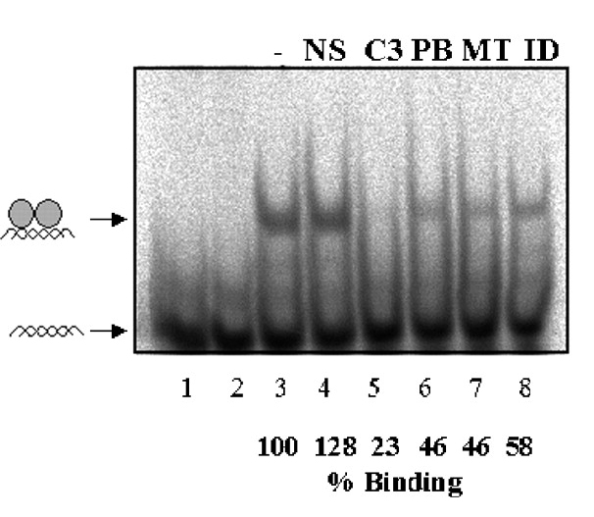
Native gels
In a native (non-denaturing) gel, no SDS is added; the
proteins separate on the basis of charge and size/shape
Proteins in a native gel do not necessarily
separate strictly on the basis of their molecular weight
Here, protein-DNA interaction is
maintained in gel

Slide 24
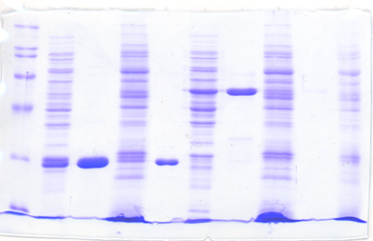
Visualizing proteins in acrylamide gels
Coomassie Brilliant Blue: 50-100 ng protein per band
Silver stain: ~10 ng protein per band
SYPRO Ruby stain: ~2-4 ng protein per band
Coomassie Brilliant Blue R-250
Commassie dye binds to basic and aromatic amino
acid residues (Lys, Arg, His, Phe, Tyr, Trp)
Presence of acid (AcOH) enhances interaction of the dye
with amino acid residues

Slide 25
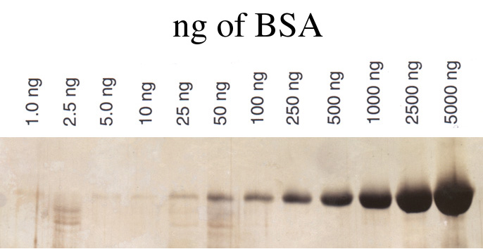
Visualizing proteins in acrylamide gels
Silver stain: Interaction of Ag⁺ with charged and
S-containing amino acids;
Ag⁺ is then reduced to metallic Ag.
This staining technique is extremely sensitive to subtle
changes in assay protocol → inconsistent results.

Slide 26
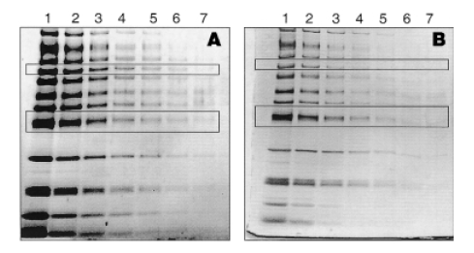
Visualizing proteins in acrylamide gels
SYPRO Ruby fluorescent protein stain:
ng of protein
150 75 37.5 18 9 4.5 2.3
150 75 37.5 18 9 4.5 2.3
SYPRO Ruby
Silver stain
Bind noncovalently and do not alter protein structure;
reversible

Slide 27
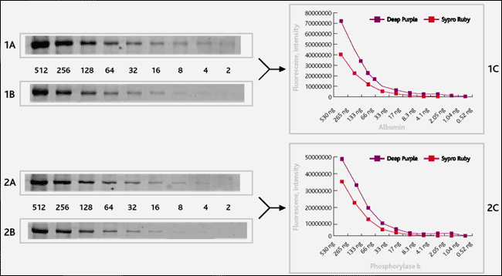
Visualizing proteins in acrylamide gels
Deep Purple stain
1 cont.
Deep Purple
kDa
200
SYPRO Ruby
97
Deep Purple
66
45
SYPRO Ruby
31
22
Both stains require use of an
appropriate fluorescence imager

Slide 28
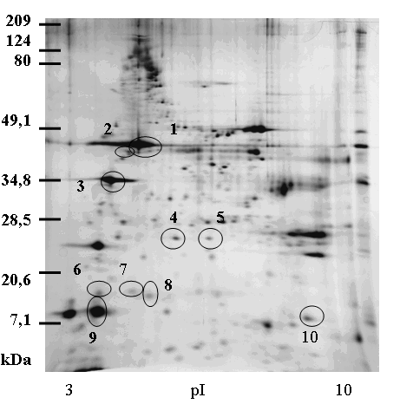
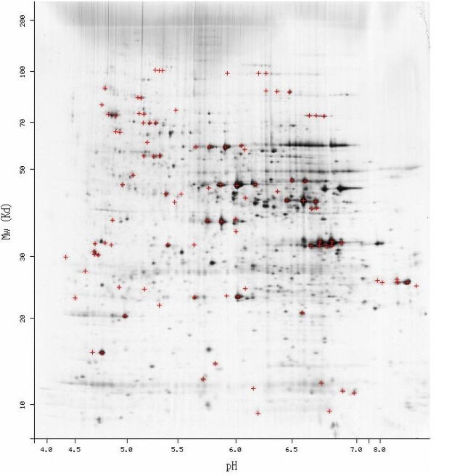
Two-dimensional gels
Obviously, with standard SDS-PAGE, some proteins might
not be resolved if they have close MW.
Two-dimensional gels can be run to achieve separation by
• size in one dimension
• isoelectric point in the other direction
Isoelectric point (pI) is the pH at which the protein has a net charge of zero

Slide 29
Methods for determining protein concentration
Other than peptide backbone, proteins typically have little
in common – chemical properties vary with aa composition
Lowry procedure. Cu²⁺ along with phosphomolybdic and
phosphotungstic acid. Cu²⁺ is converted to Cu⁺ by Cys,
Tyr, Trp, and others. Cu⁺ reacts with Mo and W acids to
give a dye.
BCA method. Similar to Lowry, except Cu⁺ reacts with
bicinchoninic acid (BCA) to form a purple complex.
BCA
BCA-Cu complex

Slide 30
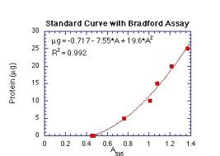
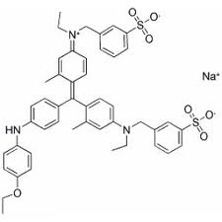
Methods for determining protein concentration
Analysis based on dye binding
The Bradford assay is a rapid and reliable technique that uses the dye Coomassie Brilliant Blue G-250, which undergoes a change in color upon noncovalent binding to proteins.
The binding is quantitative and is less sensitive to variations in the protein’s amino acid composition.
The color change is easily measured by a UV-vis spectrophotometer.
Notes:
G-250 dye actually missing two C-CH3 groups on central aromatic rings

Slide 31
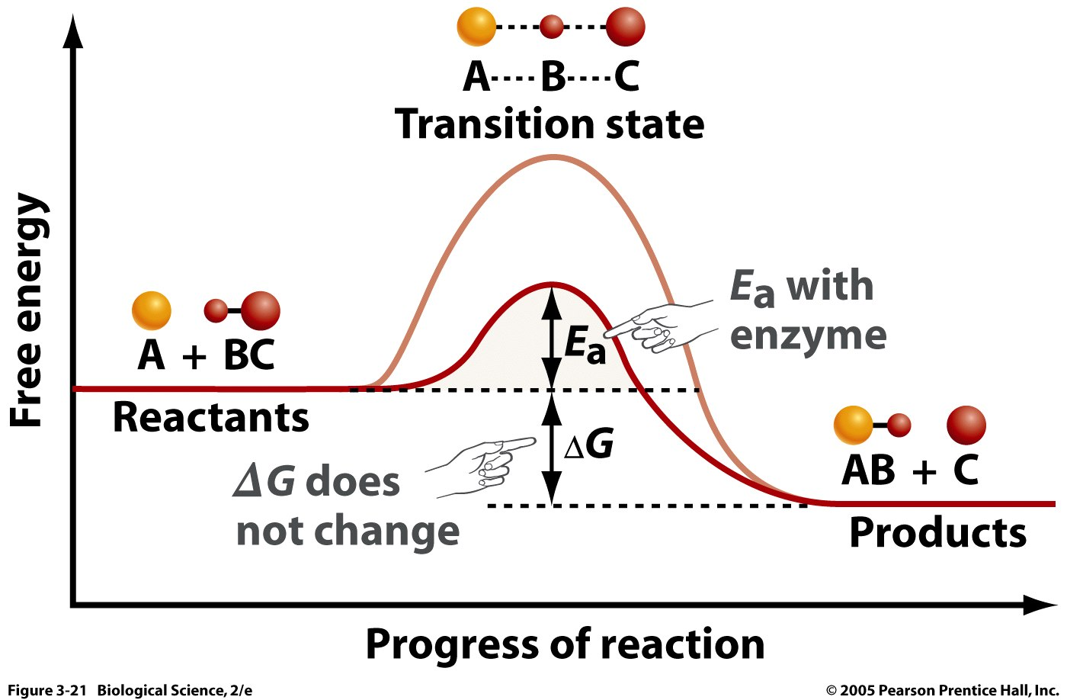
Enzyme kinetics
• Rates at which enzymatic reactions occur
• Allows us to compare enzymes, inhibitors, etc.
A catalyst decreases the activation barrier for a reaction.
A catalyst equally accelerates the forward and reverse
reactions — equilibrium constants remain unchanged

Slide 32
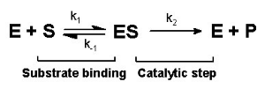
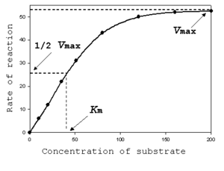
Enzyme kinetics
An enzyme can be saturated with substrate
As the enzyme becomes saturated, the rate reaches the
maximal velocity (V_{max}), expressed in product formed per time
k_{cat} = V_{max}/[enzyme sites]
K_{M} is the substrate concentration
at which the rate is half of V_{max}

Slide 33
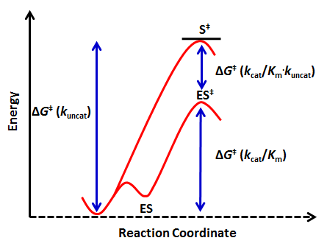
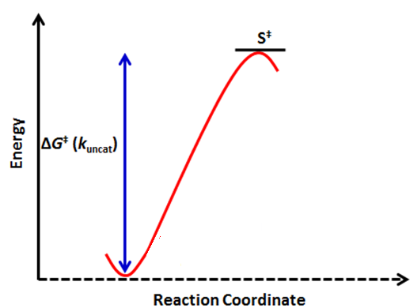
Important Kinetic Parameters
Catalytic proficiency
Catalytic efficiency
The catalytic efficiency allows one to compare the activity of enzymes in a meaningful manner

Slide 34
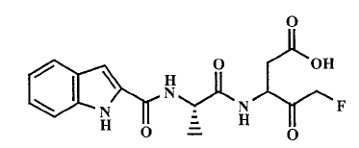
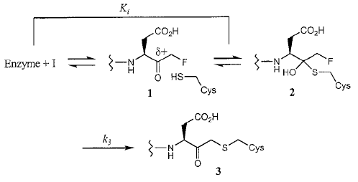
Enzyme inhibitors
Reversible inhibitor: removal of inhibitor restores enzyme activity.
Irreversible inhibitor: activity cannot be restored, typically because an active site residue has been covalently modified
“warhead”

Slide 35
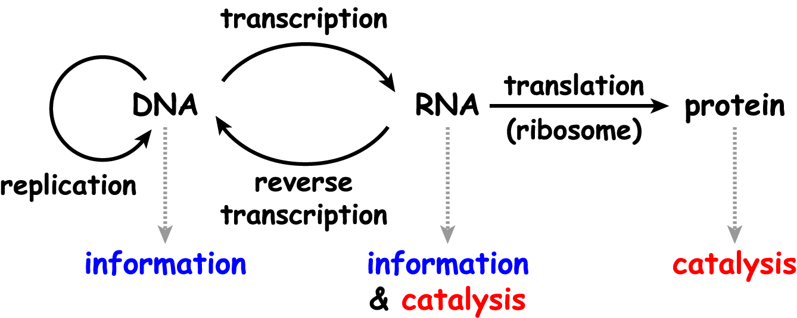
Relationships among the biopolymers
This provides the framework for understanding all of the chemistry and biology of nucleic acids

Slide 36
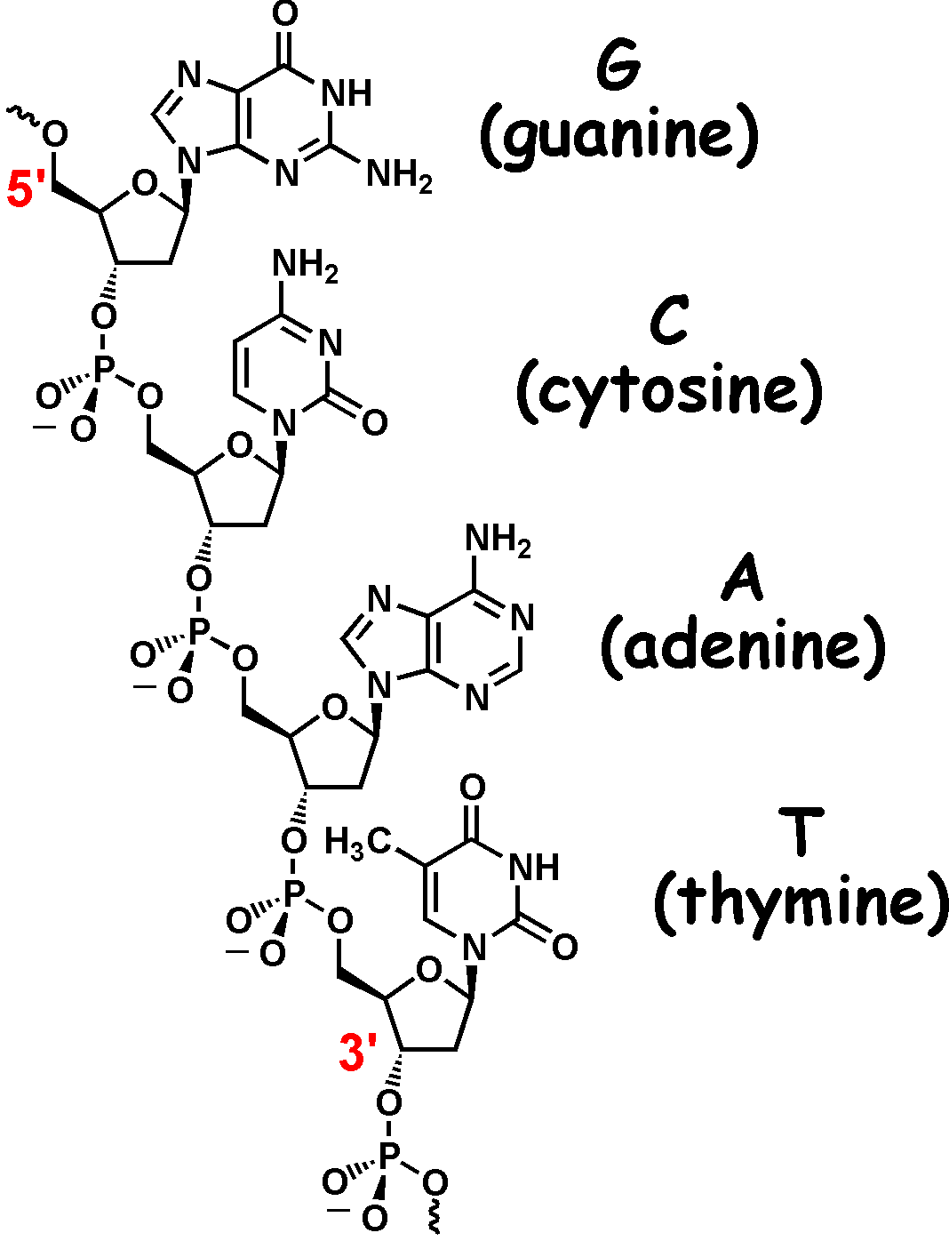
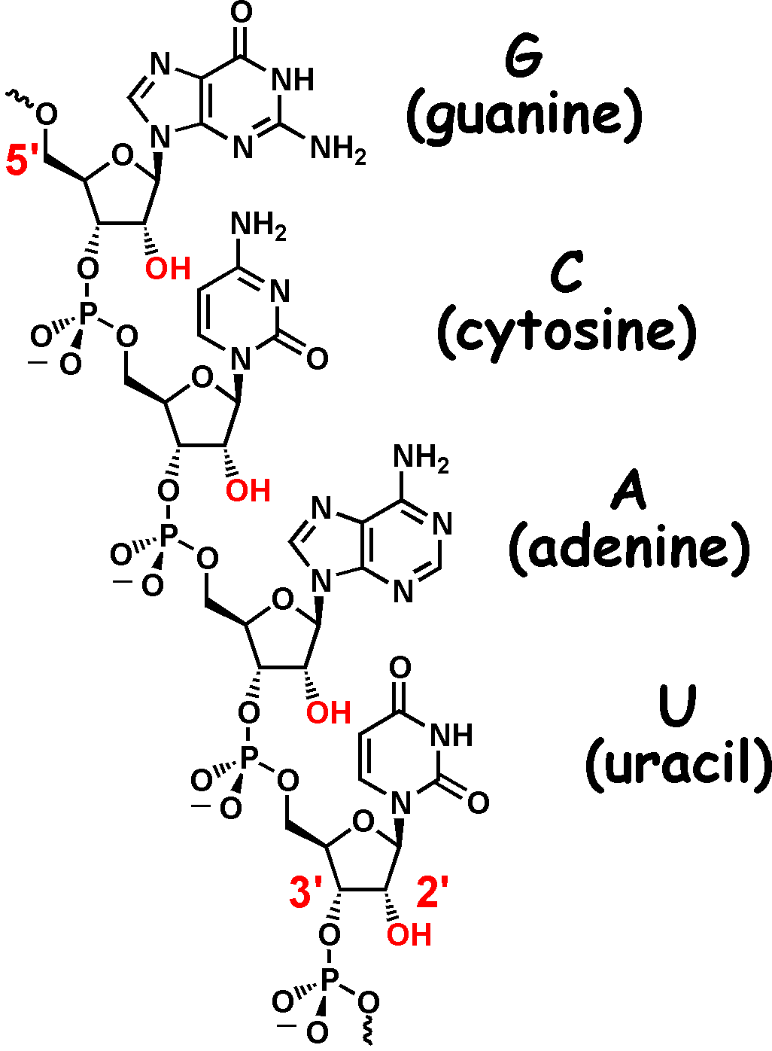
Nucleic acids
DNA
RNA
G and A are purines; C and T/U are pyrimidines

Slide 37
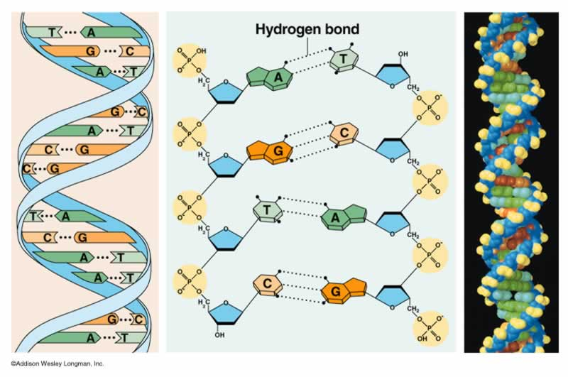
DNA exists as a double helix

Slide 38
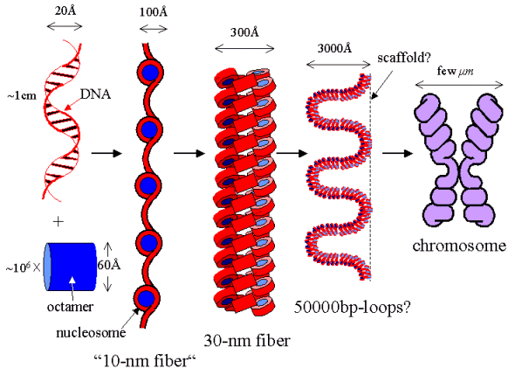
Eukaryotic DNA is packaged in chromosomes
The human genome has 3 billion base pairs of DNA
• Two meters of DNA must be stored in a micrometer-sized cell
• Need mechanism for compaction that still allows access
Complex of DNA and protein is called chromatin
“nucleosome”
~200 bp of DNA
associated with octamer of 4 histone proteins:
(two molecules each of H2A, H2B, H3 and H4)
Notes:
histones - highly conserved in eukaryotes; not found in bacteria

Slide 39
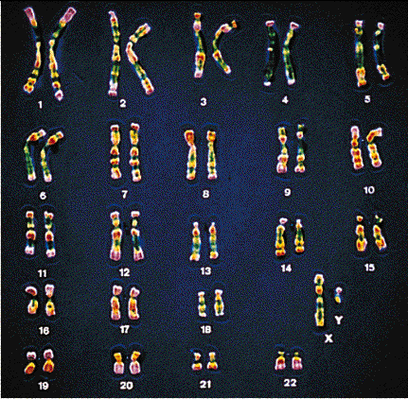
Chromosomes
Each human cell (with a few exceptions) contains two copies of each chromosome, one inherited from the father and one inherited from the mother.
Females have two X chromosomes, and males
have one each X and Y chromosomes.
(22 x 2) + 2 = 46 chromosomes
How many chromosomes do the following species have?
Corn
Fireflies

Slide 40
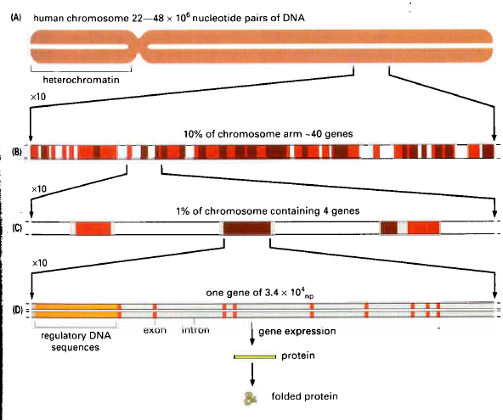
Genome to protein
Only 1–2% of eukaryotic DNA codes for proteins!
Large stretches of non-coding regions within each gene:
• Average gene size is 27,000 bp
• 1,300 bp required to encode the average protein
• The rest of the DNA is introns, which interrupt the exons

Slide 41
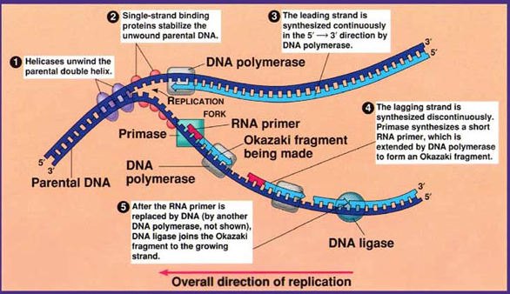
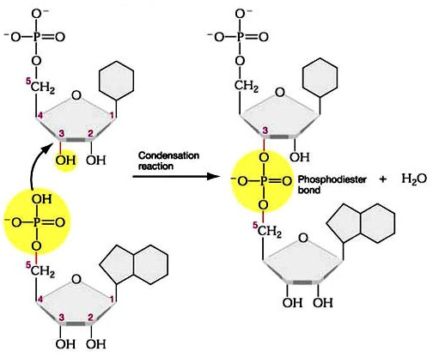
DNA replication

Slide 42
Telomeres
Telomere: Many tandem repeats of short sequence
(humans GGGTTA, extending for ~10,000 nt)
50–100 nt are lost during each cell division
After many generations, daughter cells will inherit
defective chromosomes; cells will die or no longer divide
Telomeres are potential “measuring sticks” for the cell to count cell divisions and to protect against uncontrolled growth (cancer)

Slide 43
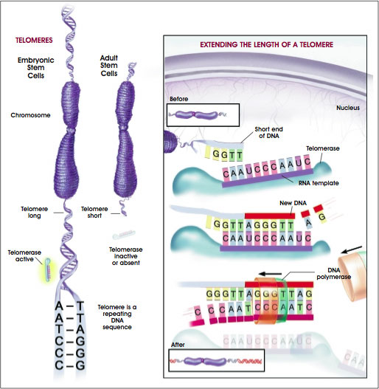
Telomerase is an enzyme that extends telomeres
Telomerase binds
Telomerase extends
DNA polymerase
can then prime and
synthesize ends
Notes:
Note that “short end of DNA” is the 3’-end; it is extended with dNTPs using the telomerase RNA template by the enzyme telomerase reverse transcriptase (TERT). Referring back to Slide 2-16, extending the 3’-end via telomerase means that the lagging strand can be longer at its 5’-end, because the RNA primer now binds to the 3’-extended nucleotides.

Slide 44
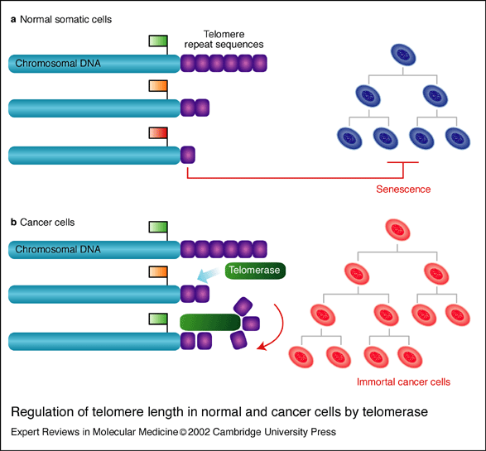
Telomerase as an anti-cancer target

Slide 45
RNA synthesis: Transcription
All cells, from bacteria to humans, follow the central dogma:
DNA RNA protein
Big difference between prokaryotes and eukaryotes:
RNA splicing occurs only in eukaryotes
Nobel Prize in Physiology
or Medicine (1959)
to Severo Ochoa
Nobel Prize in Chemistry (1959)
to Roger Kornberg

Slide 46
RNA synthesis: Transcription
Transcription produces RNA that is
complementary to one DNA strand
• Transcription of RNA proceeds in 5’→3’ direction
(i.e., DNA information is “read in 3’→5’ direction”)
• Unlike replication, the product RNA strand does NOT
remain H-bonded to the DNA template. The RNA is
displaced, and the DNA double helix is formed again.
• Three phases in both prokaryotes and eukaryotes:
Initiation, Elongation, Termination
It is important to understand prokaryotic transcription!

Slide 47
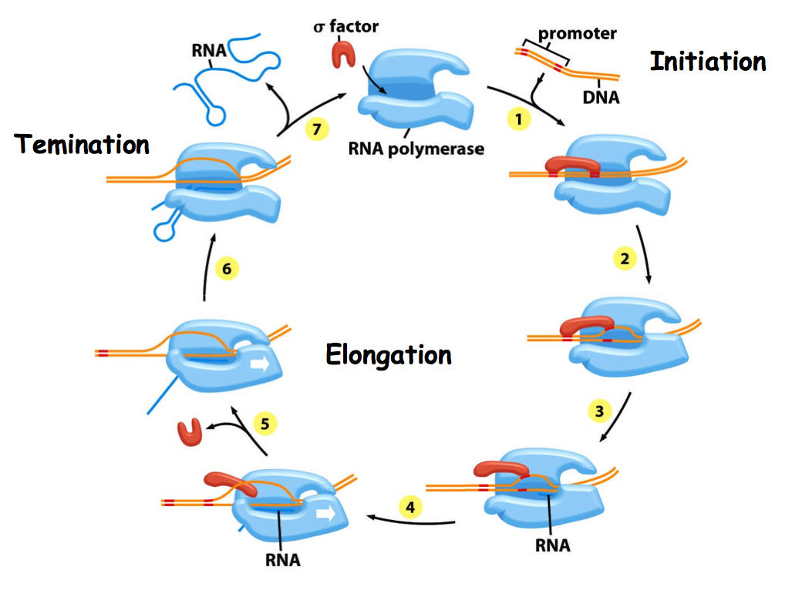
RNA synthesis: Transcription

Slide 48
Transcription in prokaryotes: Termination
For most genes, the termination sequence has
1. Two-fold symmetric DNA sequence;
when transcribed, the RNA forms a hairpin
2. A string of A–T base pairs
Hairpin structure
forces RNA away from the polymerase.
This is enhanced by the weak A–U bonds at the DNA-RNA hybrid site
GAATAC….CTG….GTATTC

Slide 49
Transcription in eukaryotes
The DNA does not leave the nucleus,
so transcription happens in the nucleus.
RNA polymerase I (Pol I):
transcribes ribosomal RNA (rRNA)
RNA polymerase II (Pol II):
transcribes messenger RNA (mRNA)
RNA polymerase III (Pol III):
transcribes transfer RNA (tRNA)
Notes:
Note that rRNA, mRNA, and tRNA are sort of in size order, to match Pol I, Pol II, and Pol III

Slide 50
Transcription in eukaryotes: Initiation
Promoter is usually ~50 bp from transcriptional start site
Purified Pol II cannot initiate transcription in vitro
Transcription factors are required to
• position Pol II at promoter
• pull apart the DNA strands
• release Pol II from the promoter after initiation
Transcriptional activators
are modular proteins:
• DNA-binding domain
• Activation domain

Slide 51
Post-transcriptional modifications
Prokaryotes: primary mRNA transcripts are ready for translation
Eukaryotes: pre-mRNA made in nucleus; translation in cytoplasm
post-transcriptional processing takes place in nucleus
1. 7-methylguanosine “cap” added to 5’-end
FUNCTION: prevents nuclease action; facilitates ribosome recognition
2. poly-A tail added to 3’-end by poly-A polymerase
FUNCTION: stability; facilitates transfer to cytoplasm
3. Introns are spliced out to form final mRNA
FUNCTION: obtain different protein sequences

Slide 52
Transcription: prokaryotes versus eukaryotes
Prokaryotes
Eukaryotes

Slide 53
Biochemical analysis of DNA
Agarose is used for DNA strands over ~300 bp. Bands greater than 100,000 bp are not resolved.
Concentration of agarose can be increased to create a denser matrix, or decreased to create a less dense matrix.
Larger molecules need a less dense matrix.
Because DNA is negatively charged, it migrates to the cathode (+) of the electrophoresis system.
This migration is based solely on size because dsDNA has a constant shape and charge density.

Slide 54
Staining DNA/RNA gels
DNA stains are typically intercalating agents that increase
their fluorescence upon DNA/RNA binding
1.5% Agarose
Illumination
at 312 nm
Ethidium bromide
• Intercalates into dsDNA, 1 EtBr molecule per 4-5 bp
• Fluorescence enhanced 30-fold upon nucleic acid binding
• Effective for dsDNA; less effective for ssDNA, RNA
• Can detect >10 ng of dsDNA

Slide 55
Staining DNA/RNA gels
Newer dyes have 100-fold fluorescence enhancement
upon binding
Can detect >25 pg of dsDNA
SYBR Green
SYBR Gold

