Slide 1
CHEM 570, Fall 2017
Concepts in Chemical Biology
Lecture 19a
Kinases and Phosphotases:
Characterization and inhibitor development

Slide 2
Phosphorylation – an important PTM
Protein phosphorylation activates or inactivates
Changes protein charge
Alters conformation
Dynamics of multi-protein complexes
Changes subcellular localization
Misregulation of phosphorylation
Cancer
Metabolic disorders
Neurodegenerative diseases
‘Signal’
Cell growth/proliferation
Differentiation
Viability/survival
Homeostasis
Effector function (e.g. cytotoxicity, cytokine production)
Cell death
Notes:
Kinase function extends beyond capacity to phosphorylate other proteins
In addition to catalytically active kinase domain, most kinases feature highly dynamic regulatory domains that govern their activity
Scaffolding proteins to form multi-enzyme complexes
Competing for and disrupting protein-protein interactions

Slide 3
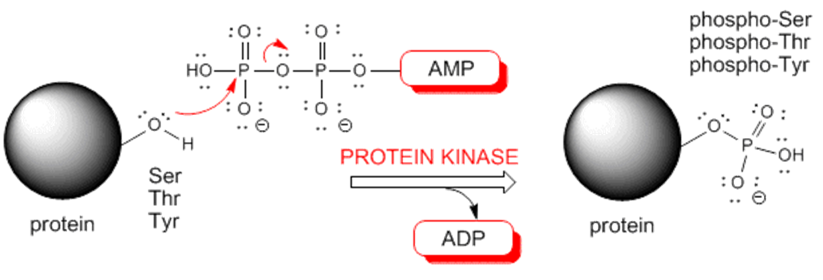
Protein Kinases – phosphorylating enzymes
responsible for phosphryl transfer from a donor (e.g., ATP) to a peptide or protein acceptor
Ser, Thr, Tyr the most common phosphorylated residues (His, Asp)

Slide 4
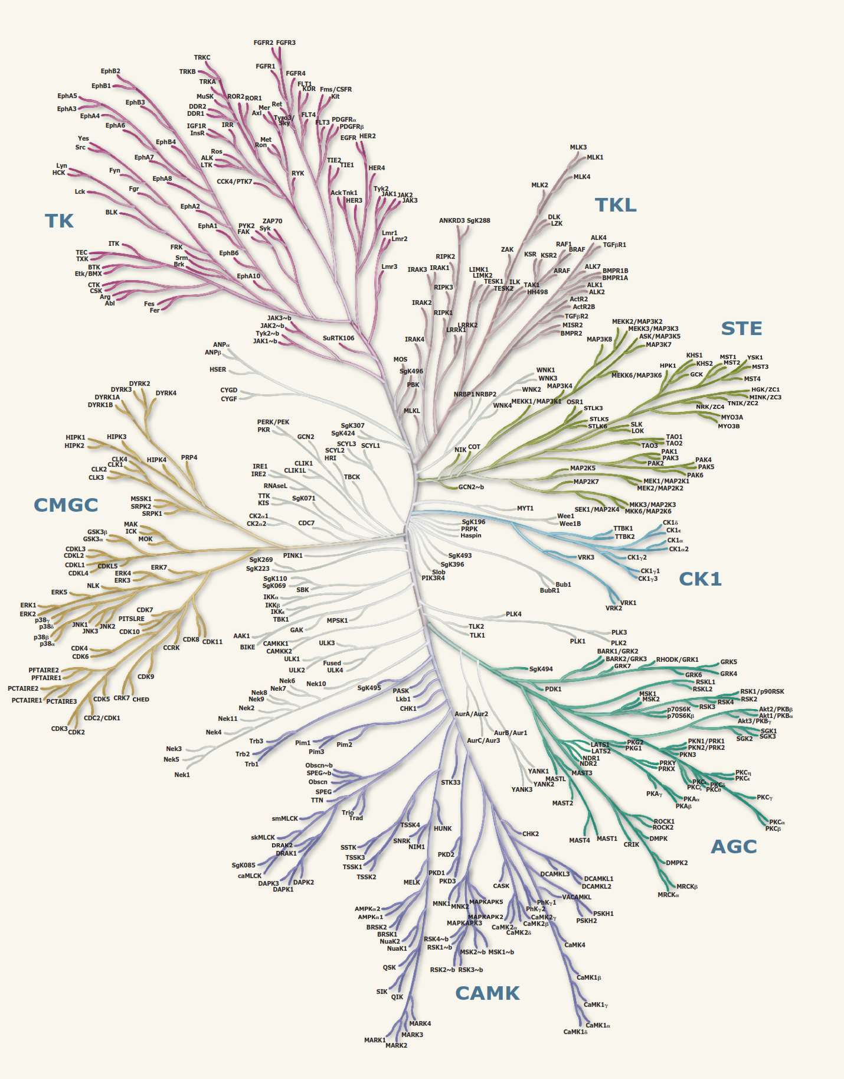
The human kinome
30% of all proteins may be modified
518 protein kinase genes = human kinome space
20% of all eukaryotic genes
218 genes = human diseases
~30 = tumor suppressor
~100 dominant oncogenes
Notes:
MAPKs – mitogen activated protein kinases
CDKs – cyclin dependent kinases
GSK-3 glycogen synthase kinase 3
~85% of all phosphorylation sites consist of serine or threonine

Slide 5
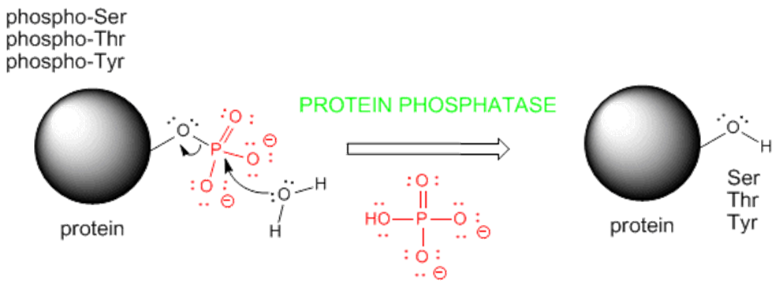
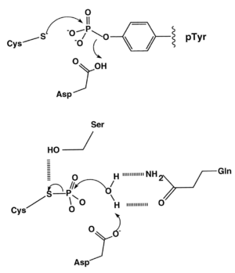
Phosphatases – dephosphorylating enzymes
grouped into three main classes based on sequence, structure and catalytic function
1. phosphoprotein phosphatase (PPP)
2. protein Tyr phosphatase (PTP)
3. aspartate-based protein phosphatase

Slide 6
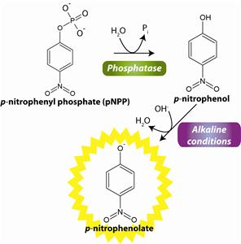
Monitoring phosphatase activity
phosphatase activity can be readily monitored using a variety of colorimetric or fluorescent probes
phosphate group quenches fluorescence but upon removal, signal is restored
a)
b)
c)

Slide 7
Methods to Monitor Kinase activity
Traditional assays:
Antibodies specific for the phosphorylated (activated) kinase, common proxy for kinase activation
Radioactivity-based measurements, monitor transfer of γ-phosphoryl from [γ-³²P]ATP
Drawbacks:

Slide 8
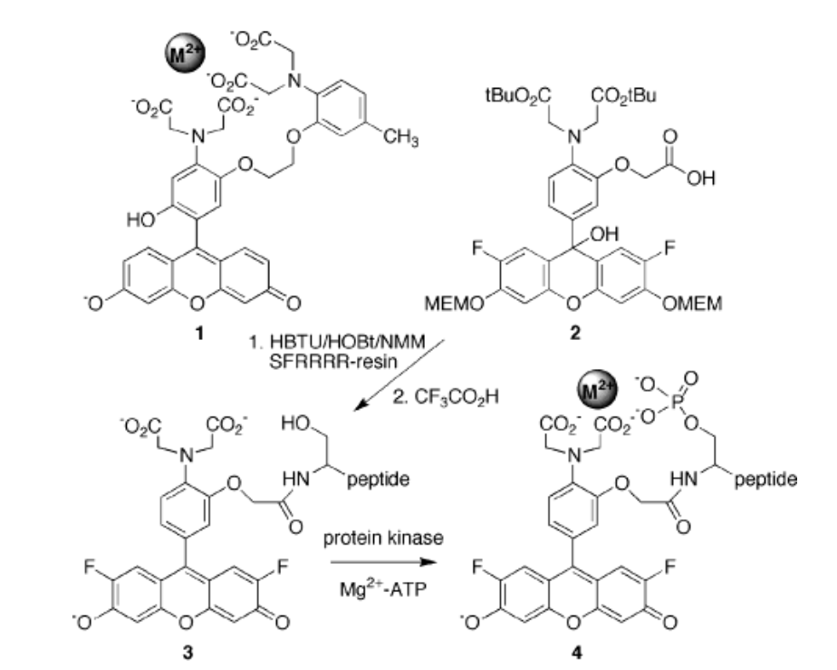
CHEF-based kinase probes
Chelation-sensitive fluorophores manifest altered fluorescent properties upon chelation of various metals
Advantages: Kinase-specific peptides easy to prepare (SPPS, Lecture 7)
unique consensus sequence of 4-5 a.a. flanking
Chen et al., J. Am. Chem. Soc. 2002, 124, 3840

Slide 9
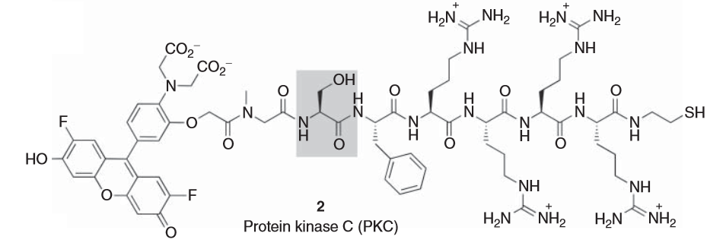
CHEF-based kinase probes
Report on activity in continuous assays,
Compatible with cell lysates and tissue homogenates
Small-molecule inhibitor screening
Protein Kinase C activity
Chen et al., J. Am. Chem. Soc. 2002, 124, 3840

Slide 10
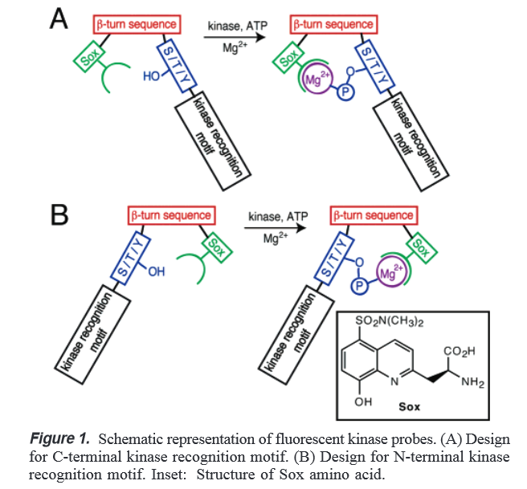
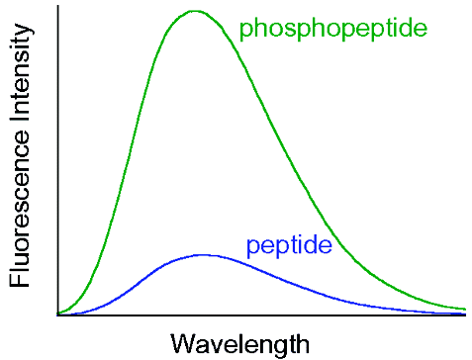
β-Turn-focused kinase activity probes
XaaPro or ProXaa
Shults et al., J. Am. Chem. Soc. 2003, 125, 14248

Slide 11
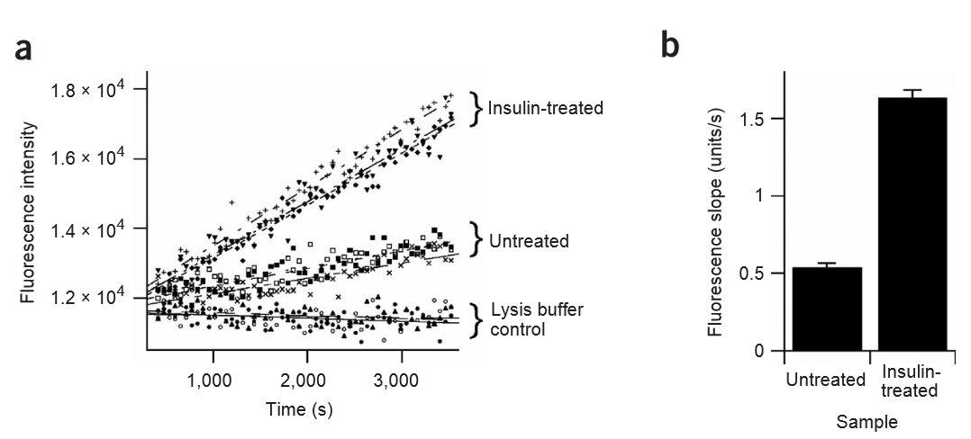
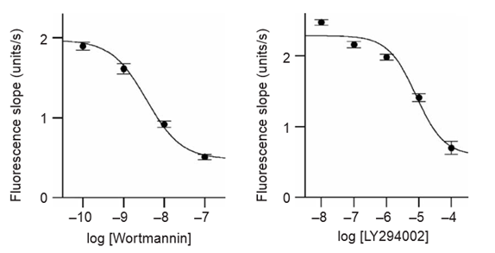
Applications
phosphoinositide 3-kinases (PI3Ks) inhibitors
Notes:
phosphoinositide 3-kinases (PI3Ks)
PI 3-kinases are also a key component of the insulin signaling pathway

Slide 12
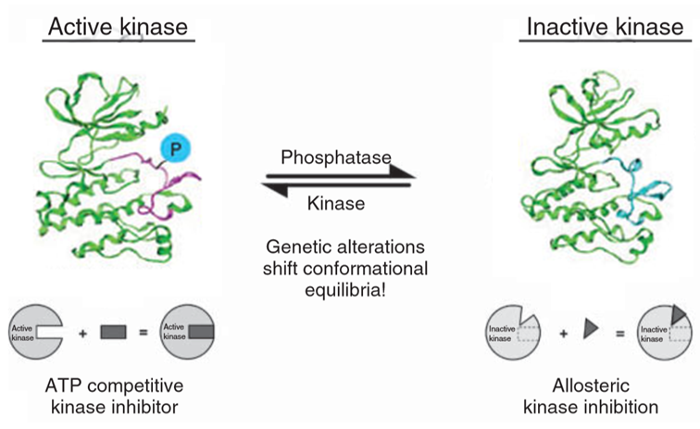
Design of Kinase Inhibitors
Classic inhibitors compete with ATP
• poor selectivity and high likelihood of off-target inhibition
Solution: identify binding sites made available when kinases adopt inactive confirmation
Notes:
Inhibitor affinities (Kd) and potencies (IC50) from in vitro profiling only part of the story
Must consider kon and koff rates
Improve interactions to increase residence times

Slide 13
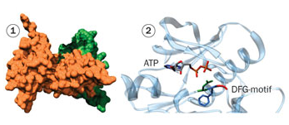
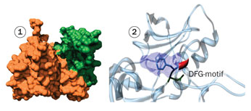
Targeting the DFG-out pocket
DFG-out pocket (allosteric pocket) is adjacent to ATP binding site
Amino acids lining this pocket are less conserved than ATP site
Active:
ATP binding site partially occluded by Phe of DFG motif
Inactive:

Slide 14
FLiK: Kinase inhibitor screening
Label kinase with environmentally-sensitive fluorophore
Remove solvent exposed cys and replace with ser
Insert cys into desired position in kinase to attach thiol-reactive fluorophore (Lecture 6)
Activation loop exhibits flexibility or will undergo conformational change
Simard et al., Nat. Chem. Biol. 2006, 2, 358
Simard et al., J. Am. Chem. Soc. 2009, 131, 13286
Notes:
Daniel Rauh
Chemical Genomics Centre of the Max Planck Society, Dortmund, Germany.
Thiols better than amines because reaction more complete and lower abundance of free thiols in proteins
BLAST to search for other kinases with highest percent sequence identity
PyMol to analyze crystal structures
Swiss Modler to generate 3D structural models with no crystal structure available

Slide 15
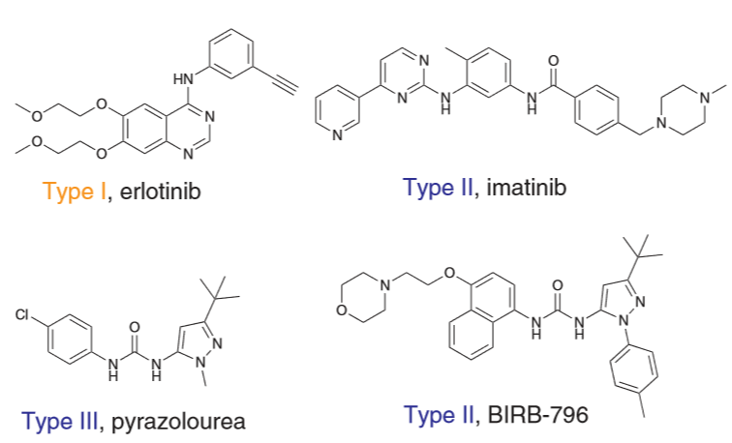
Identifying allosteric inhibitors of cSrc
cSrc is overexpressed or upregulated in gastrointestinal and prostate cancers
target kinase for tumor therapy but allosteric inhibitors known
Type I (classic)
Type II and III (allosteric)
Simard et al., Nat. Chem. Biol. 2006, 2, 358

Slide 16
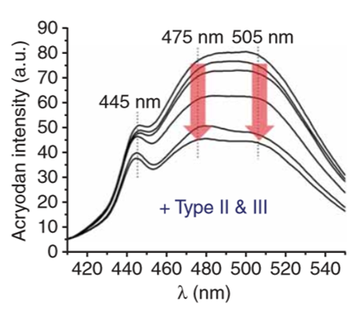
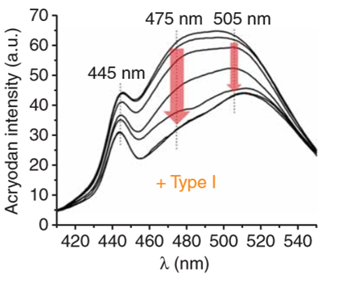
Identifying allosteric inhibitors of cSrc
Type I ligands induce a robust loss of fluorescence intensity at 475 nm and a shift from 505 nm to 510 nm
Type II and III inhibitors stabilize the inactive kinase conformation and elicit an equally reduced emissions at 475 nm 505 nm
Simard et al., Nat. Chem. Biol. 2006, 2, 358
Notes:
Signal at 445 nm less sensitive to ligand binding and serves as an internal reference point (ratiometric measruements)

Slide 17
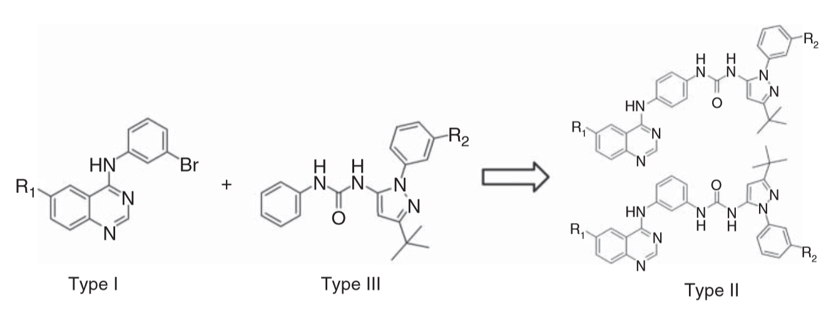
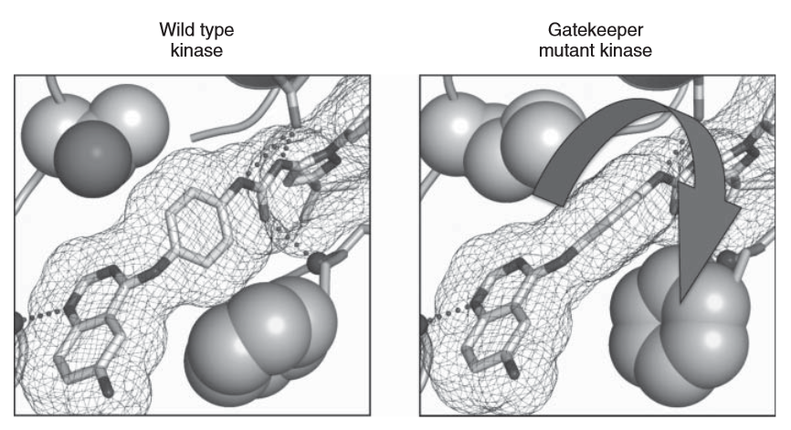
Identifying allosteric inhibitors of cSrc
4-aminoquinazoline
pyrazoloureas
Fusion of two fragments resulted in significantly higher binding affinities
Gatekeeper mutation common in drug resistant cSrc
Type II hybrid can freely rotate to adapt to larger gatekeeper residue
Notes:
Gatekeeper residue is a conserved, residue in the ATP binding pocket of protein kinases
Critical determinant for selective inhibition within kinase families
Signle recurring mutation at the gatekeeper position results in drug resistance of several target kinases including BCR-Abl (CML)
Bulkier residue at gatekeeper sterically impedes binding of inhibitors in active site of kinases → shifts equilibrium from inactive to active ATP binding

Slide 18
iFLiK: Discovery of Inter-Domain Stabilizers
iFLiK can detect more complex changes in conformations such as intramolecular interdomain interactions
Ser/Thr kinase Skt – key role in signaling pathways responsible for cell survival, proliferation, and apoptosis (Cancer target!!)
kinase domain allosterically regulated by phosphatidylinositol lipids that bind to PH domain
ATP binding site not available in inactive form
Fang et al., ACS Chem. Biol. 2015, 10, 279
Notes:
In 2005 researchers from Merck reported discovery of Akt inhibitors that only inhibited full-length kinase but not the kinase domain alone
Investigation revealed inhibitors bind at interface of the PH and kinase domain
Resulted in development of clinical candidate MK-2206 (phase ii as of August 3, 2015)

Slide 19
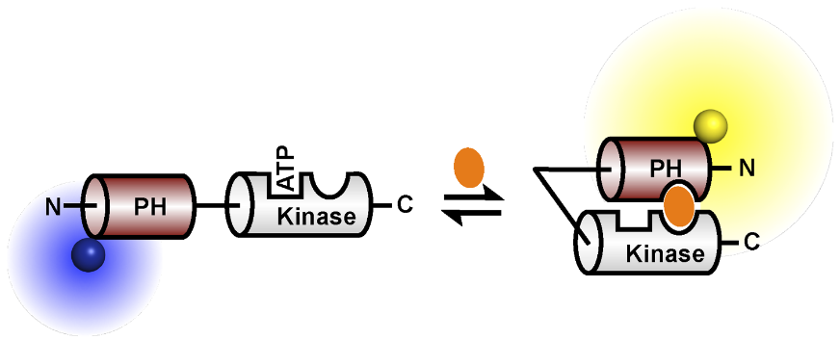
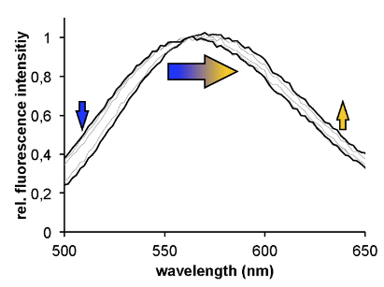
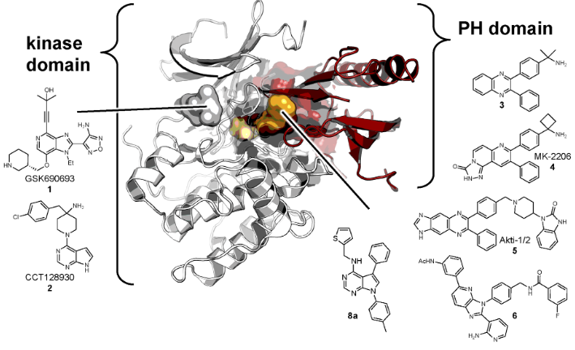
iFLiK: Discovery of Inter-Domain Stabilizers
Glu49Cys mutation
Screened 10,000 compounds
24 hits displayed >25% binding relative to MK-2206
Fang et al., ACS Chem. Biol. 2015, 10, 279

Slide 20
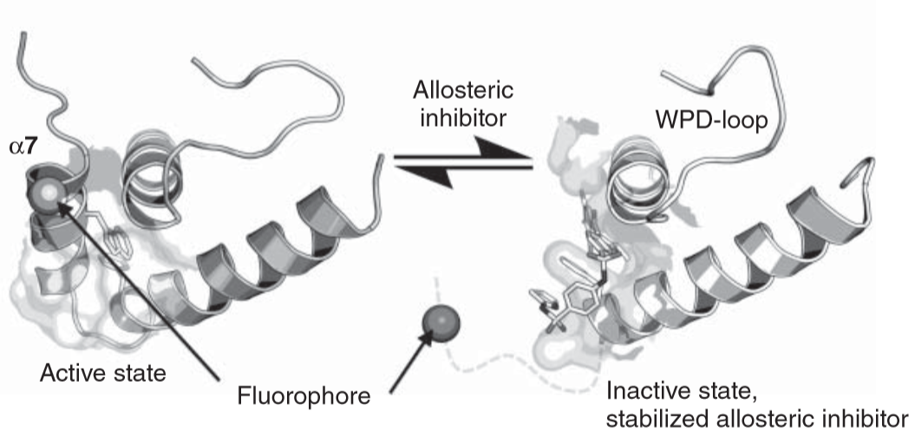
Screens for Phosphatase Inhibitors
Notes:
Active sites very similar → off target inhibition
Discover negatively charged compounds, poor bioavailability and poor cell permeability

Slide 21
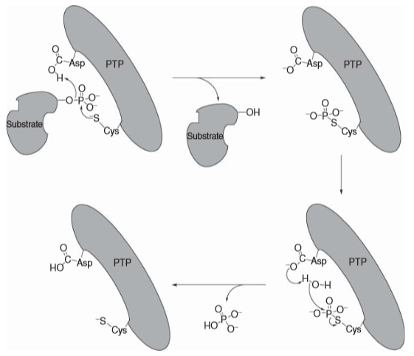
Mechanism of Tyrosine Phosphatases
Development of clinically relevant phosphatase inhibitors – limited selectivity and unfavorable pharmacokinetics (reason?)
No FDA approved phosphatase inhibitors for human diseases
Target allosteric site, e.g. PTP1B, activity associated with type II diabetes
Conserved sequences CXXXXXR

Slide 22
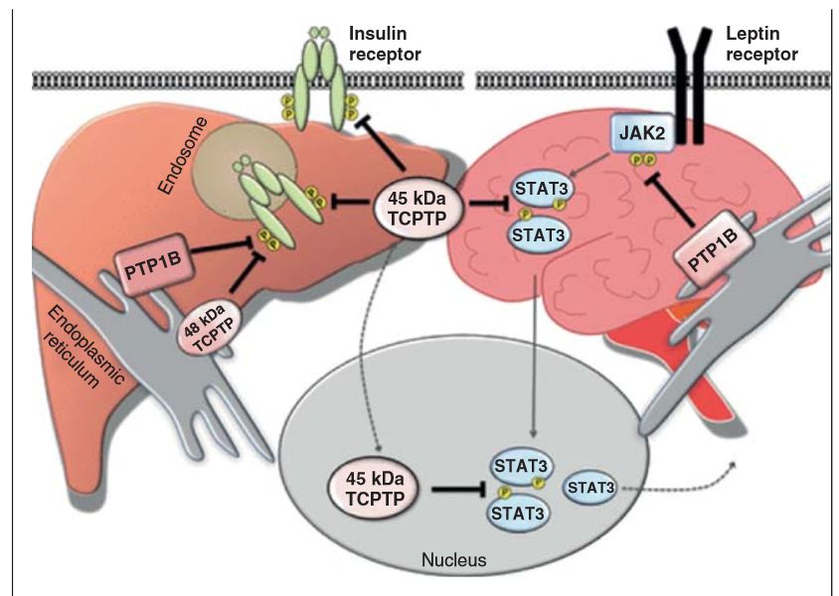
PTP1B, an important inhibitor target
PTP1B attenuates insulin signaling by dephosphorylating the insulin receptor

Slide 23
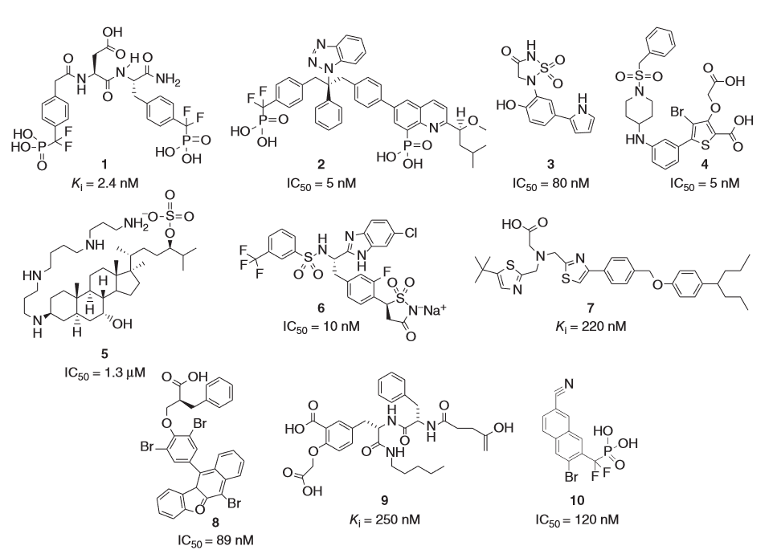
Known PTP1B inhibitors
Notes:
Notice how all examples are intrinsically negatively charged

Slide 24
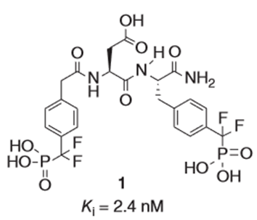
Designing bidentate ligands
Subpockets bordering active site can be targeted
Bidentate ligands can simultaneously bind to conserved active site and non-conserved subpocket
Nonhydrolyzable pY
Difluoromethyl-phosphonate
Notes:
(“aryl phosphate-binding site”)

Slide 25
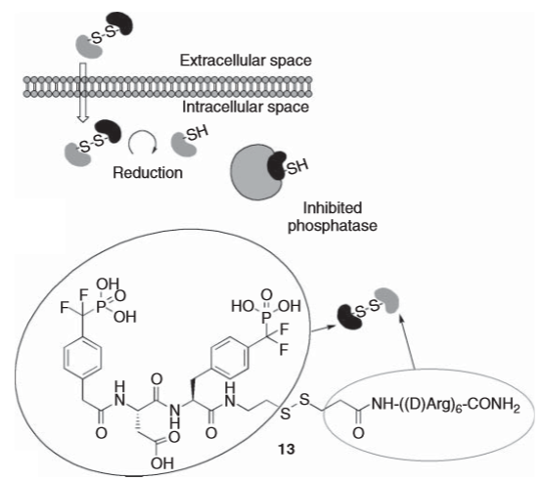
Intramolecular activation by thiols
Lee et al., Angew. Chem. Int. Ed. 2005, 44, 4242

Slide 26
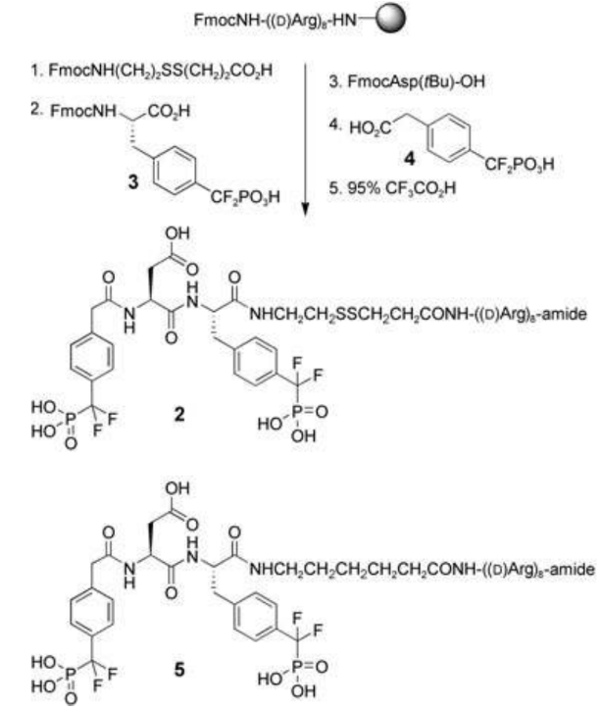
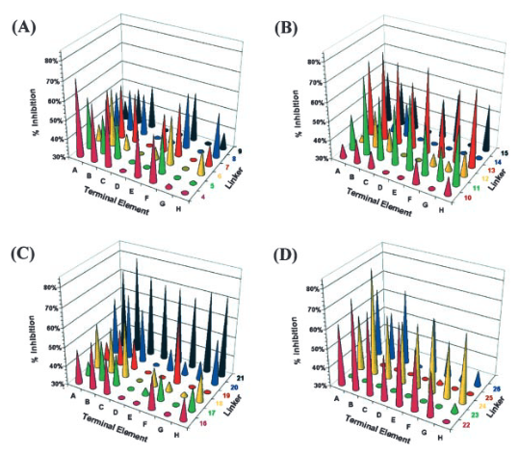
Evaluation
ELISA assay
Lee et al., Angew. Chem. Int. Ed. 2005, 44, 4242
Notes:
Positive charges of arginine stretch counteract negative charges of the inhibitor
When inhibitor attached to poly-arg tail, activity repressed via electrostatic interactions
Explain the ELISA assay you would design to screen for hits?

Slide 27
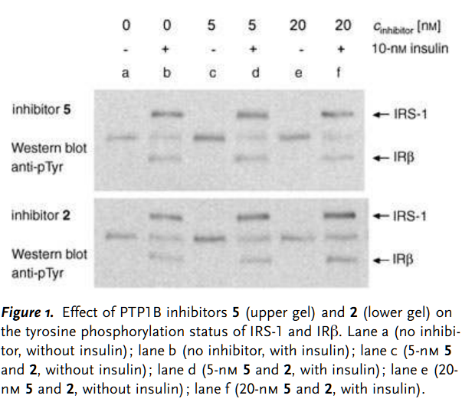
Evaluation
PTP1B contributes to type 2 diabetes by dephosphorylating
Insulin receptor (IRβ)
Notes:
insulin receptor b (IRb) subunit
Insulin receptor substrate-1 (IRS-1)

Slide 28
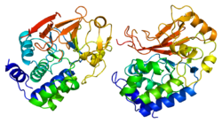
Protein Ser/Thr Phosphatases (PSTPs)
Protein phosphatase 1 (PP1) and PP2A are the most abundant PSTPs, involved in basically all cellular processes
Exists as holoenzymes composed of catalytic subunit and distinct set of interacting proteins as regulatory subunits
No selective inhibitors to date
Activators can be just as valuable
Notes:
Four PP1 catalytic subunit isoforms (α, β, γ1, γ2), 2 subunits for PP2A
Over 200 regulatory proteins control the subcellular localization, substrate specificity, and activity of PP1 and PP2A
Bind to catalytic subunit via RVxF motif (x is equal to any amino acid besides proline)

Slide 29
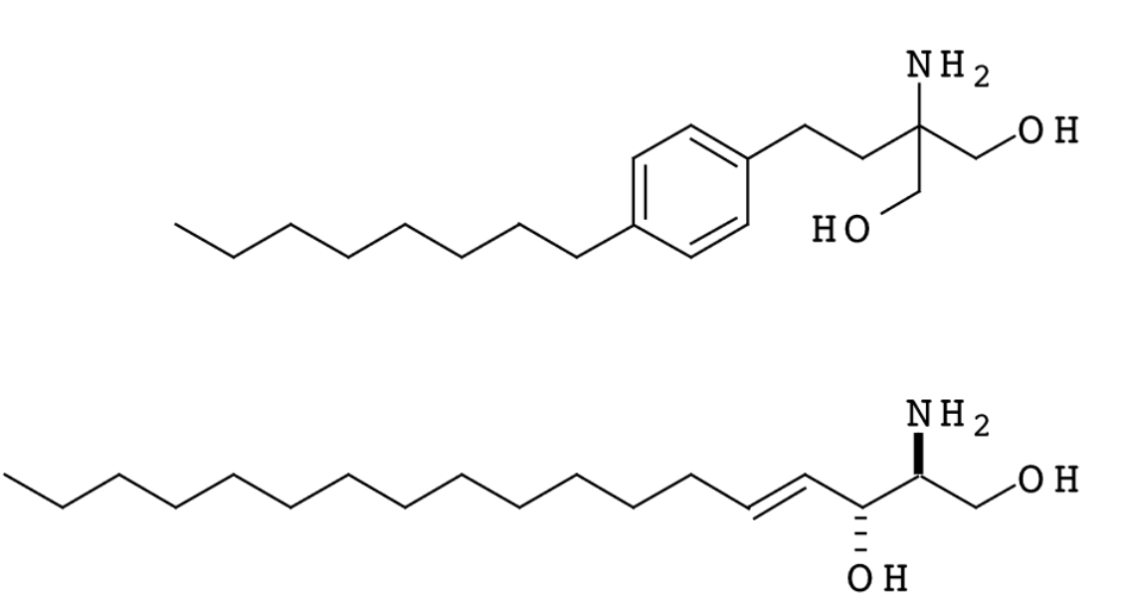
Probes for PSTPs Activation
Challenges of activator design
no general strategies available
binding sites need to be identified individually
FTY 720
Sphingosine
FTY720 is phosphorylated by sphingosine kinases and serendipitously found to be a PP2A activator
Upon activation, Akt is dephosphorylated leading to apoptosis of cancer cells
Lee et al., Science. 2002, 44, 4242
Notes:
Complex cellular response: FTY 720 also acts as a potent sphingosine-1-phosphate (S1P) receptor agonist
A few reported PP1 activators target the RVxF motif in vitro

Slide 30
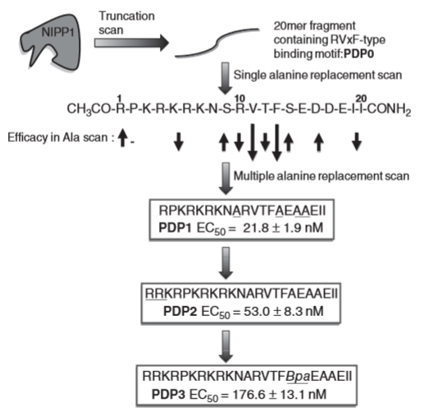
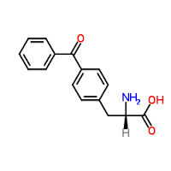
The chemical approach to PSTPs activators
Regulatory proteins (e.g., inhibitor 2 (I2) and nuclear inhibitor of protein phosphatase 1 (NIPP1) bind to PP1 to inhibit activity
Hypothesis: interrupt interaction at RVxF motif affords unbound PP1
Challenges of using peptides as chemical probes?
Cellular uptake
Proteolytic stability
Bpa =
Chatterjee et al., Angew Chemie. Int Ed. 2012, 51, 10054
Notes:
Maja Kohn - Genome Biology Unit, EMBL (Germany)
Competitive assays performed with I2 which recognizes and binds to RVxF motif on PP1
Sequential addition of arg and lys for cell penetration
If binding occurs, PP1 can dephosphorylate substrates (e.g., fluorogenic etc)

Slide 31
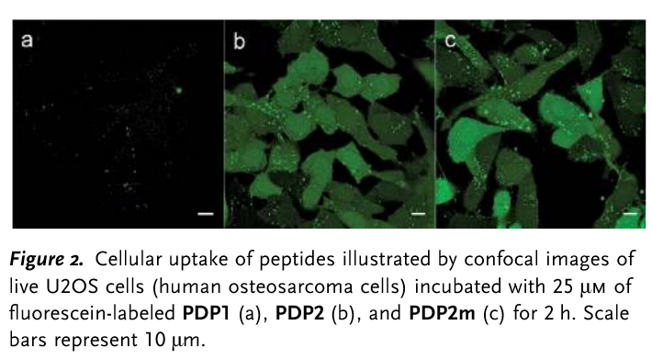
Evaluating Cell Permeability
PDP2m = RATA mutant, not active because lacking RVxF motif (important to have a control)
Chatterjee et al., Angew Chemie. Int Ed. 2012, 51, 10054
Notes:
PDP2m = RATA mutant, not active because lacking RVxF motif

Slide 32
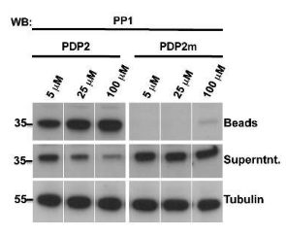
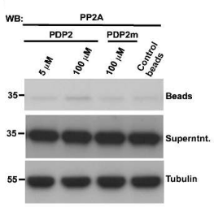
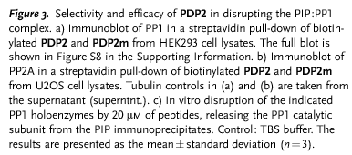
Selectivity and efficacy of PDP2
Chatterjee et al., Angew Chemie. Int Ed. 2012, 51, 10054
Notes:
Results in co-precipitation of PP1

Slide 33
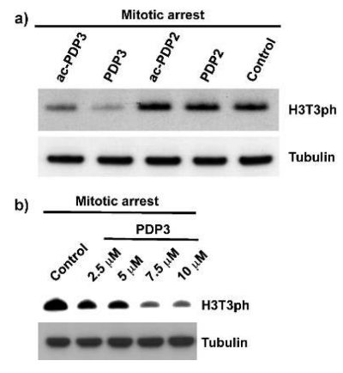
The chemical approach to PSTPs activators
Test if PDPs effect mitotic phosphorylation of histone H3 on threonine 3 (T3), a well-establish PP1 substrate
PDP2 had no effect, attributed
to lower stability inside cells
Chatterjee et al., Angew Chemie. Int Ed. 2012, 51, 10054
Notes:
Panel a and b in live cells
Ac = acetylated version
PDP2 had no effect (surprising)

Slide 34
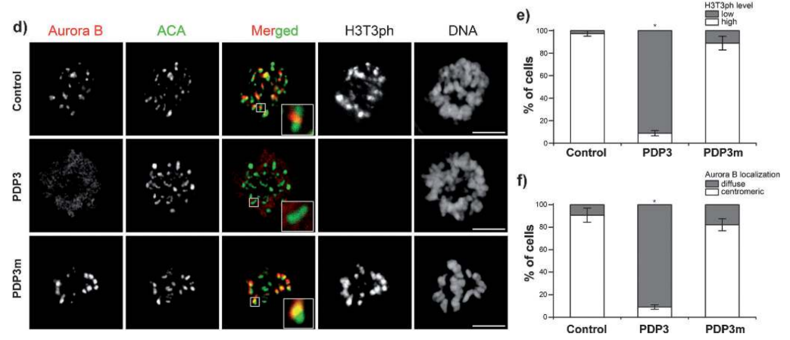
Downstream effects of histone H3 dephosphorylation
H3T3ph is a docking site for Survivin, a regulatory subunit of Aurora B kinase
ACA is a kinetochore marker
Chatterjee et al., Angew Chemie. Int Ed. 2012, 51, 10054
Notes:
It regulates targeting of this essential mitotic kinase to the centromeres during prometaphase

