Slide 1
CHEM 570, Fall 2017
Concepts in Chemical Biology
Lecture 17
Anti-cancer agents and
targeted therapeutics
Notes:
Ferrari-AmSci-2013-101-430 - targeted capsules to breach physical barriers; postulates that physics, not chemistry, is main roadblock to cancer treatment

Slide 2
Anti-cancer agents
“Cytotoxins”: kill rapidly dividing cells (slightly) better than other cells
Cytotoxins have dose-limiting toxicity on normal cells that also rapidly divide, such as intestinal cells and bone marrow (also skin, hair, etc.)
Should be considered “anti-proliferative”
rather than “anti-cancer”
“Personalized” (targeted) therapies:
Drugs that hit a cancer-specific target
http://www.whitehouse.gov/files/documents/ostp/PCAST/pcast_report_v2.pdf
Small-molecule versus biological
Notes:
“Personalized” medicine: selecting a compound/treatment based on knowing something about the precise molecular defect in the cell/disease one is trying to treat (PJH definition)
Gleevec = translocation, found in CML but not all cancer patients
Iressa = mutation, found in subset of cancer patients
Herceptin = overexpression, found in subset of cancer patients
http://www.whitehouse.gov/files/documents/ostp/PCAST/pcast_report_v2.pdf (President’s Council of Advisors on Science and Technology, Sept. 2008 report)
"Personalized medicine" refers to the tailoring of medical treatment to the individual characteristics of each patient. It does not literally mean the creation of drugs or medical devices that are unique to a patient, but rather the ability to classify individuals into subpopulations that differ in their susceptibility to a particular disease or their response to a specific treatment. (Executive Summary, page 1)

Slide 3
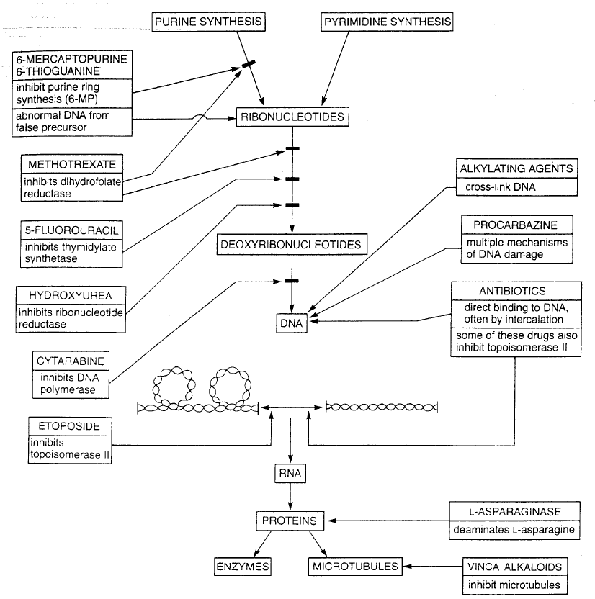
Overview of cytotoxins that act on DNA
1
DNA
alkylators
Inhibition of
DNA synthesis
(anti-metabolites)
2
4
DNA
intercalators
3
Inhibition of
topoisomerase II
5
anti-
mitotics

Slide 4
Overview of cytotoxins that act on DNA
1
Inhibition of DNA synthesis:
Anti-metabolites
Inhibition of DNA base biosynthesis
Inhibition of DNA synthesis
DNA-damaging agents
2
Anti-mitotics
DNA alkylation
Microtubule stabilizers
3
Inhibition of topoisomerase
Microtubule destabilizers
4
5
DNA intercalation & other

Slide 5
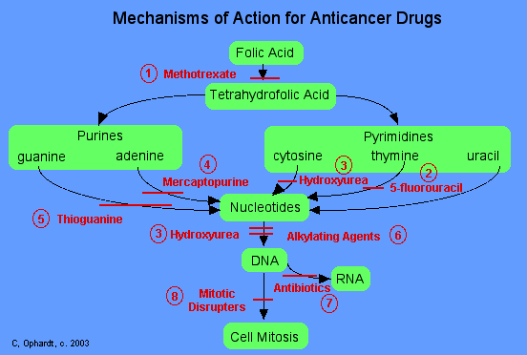
1
Cytotoxins that act on DNA:
Anti-metabolites
GOAL: Stop the synthesis of DNA and its building blocks
Folic acid, heterocyclic bases, and nucleotides
are all involved in DNA biosynthesis

Slide 6
1
Anti-metabolites
Inhibition of DNA/RNA synthesis
Inhibition of thymidine synthase (TS)
hydroxyurea
azacitidine
mercaptopurine
cladribine
clofarabine
raltitrexed
methotrexate
cytarabine
pemetrexed
cytosine arabinoside
pentostatin
dacarbazine
plicamycin
floxuridine
thioguanine
fludarabine
gemcitabine
5-fluorouracil
(prodrug is capecitabine, ftorafur)
5-fluorouracil
Inhibition of folic acid synthesis
Trimethoprim & sulfamethoxazole
Notes:
Inhibit enzymes required for DNA synthesis, or become incorporated into DNA and RNA
Prevent mitosis because DNA can’t replicate itself
Misincorporation of molecules into DNA can cause DNA damage – leading to apoptosis
Resemble nucleobases or nucleotides
Cell cycle dependent – work in the S phase (DNA synthesis phase)
Cell cycle dependence means response plateaus after a certain dose and will no longer kill cells

Slide 7
1
Anti-metabolites: methotrexate
methotrexate
DHFR
(dihydrofolate
reductase)
folic acid
tetrahydrofolate
Tetrahydrofolate is required for thymidine biosynthesis.
Therefore, methotrexate inhibits DNA synthesis
Notes:
Made in 1947
Inhibition decreases cellular levels of folate coenzymes; DNA cant be synthesized
1000 greater affinity for enzyme than folate
Can cross blood brain barrier and damage neurons – leads to memory loss. Cancer patients call this ”chemo fog” or ”chemo brain”

Slide 8
2
DNA-damaging agents: alkylators
DNA alkylating agents are typically electrophiles
thiotepa
mechlorethamine
altretamine
melphalan
busulfan
mitomycin C
cisplatin/carboplatin
nitrosoureas
mitomycin C
chlorambucil
temozolomide
cyclophosphamide
ifosfamide
lomustine
cisplatin
cyclophosphamide
Notes:
Cross linking of DNA – when cells try to replicate with cross linked DNA, DNA can break, leads to apoptosis
Cycle independent drugs, work at any point in the cell cycle
Fraction of cells that die is proportional to dose

Slide 9
2
Mitomycin C mechanism of action
Wang et al., Curr. Med. Chem. 2005, 12, 2893
Notes:
Potent - one crosslink per genome can kill a cell
Reductively activated to form mitosene, n-alkylation of 2 DNA bases

Slide 10
3
DNA-damaging agents: topoisomerase poisons
Topoisomerases cleave, unwind, and religate DNA
Topoisomerase inhibitors
camptothecin
acridinyl anisidide
camptothecin
etoposide
mitoxantrone
topotecan
teniposide
etoposide
Notes:
Topoisomerase aids in release of stress caused by tightly wound DNA
Topoisomerase I inhibitors: stabilize Top-1/DNA complexes, prevent DNA religation, induce strand breaks
Topo 2 poisons: can prevent re-ligation of DNA, target DNA/Topo II complex
Topo 2 inhibitors: prevent turnover, inhibit DNA synthesis because DNA can’t unwind properly
Camptothecin: forms ternary complex with topo I and DNA
Etoposide: forms ternary complex with topo II and DNA

Slide 11
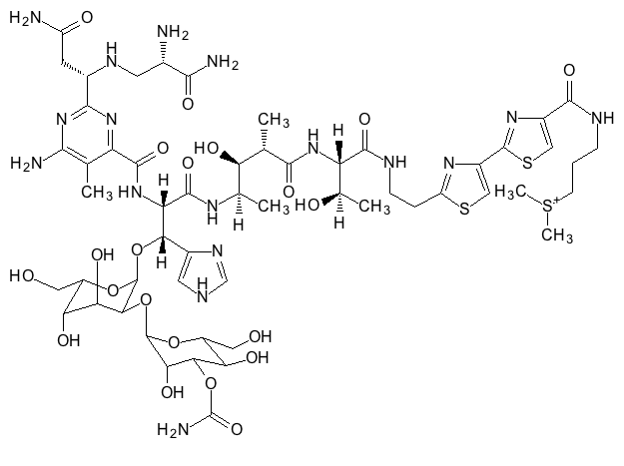
4
DNA-damaging agents: intercalators, etc.
DNA intercalators
daunorubicin
doxorubicin
idarubicin
menogarol
daunorubicin
???
DNA strand
breaks
arsenic trioxide
(As₂O₃)
bleomycin
Notes:
Intercalation can unwind DNA, lengthen DNA strand, twist base pairs, leads to inhibition of transcription and replication
Bleomycin intercalates, but also generates free radicals that damage DNA. Chelates metals, produces ROS that cleave DNA (exact mechanism unknown)
Arsenic trioxide – dates back to traditional chinese medicine, FDA approved for leukemia that is unresponsive to first line of treatment, possibly induce mitochondrial membrane permeability??

Slide 12
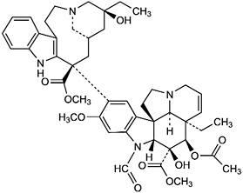
5
Anti-mitotics:
Disrupt tubulin/microtubule equilibrium
Microtubule stabilizers
Taxol/docetaxel
Taxol
Microtubule destabilizers
vinblastine
vincristine
vindesine
vinorelbine
vincristine
Vincristine and related compounds bind to tubulin,
preventing its polymerization to microtubules
Notes:
Two main groups: vinca alkaloids and taxanes
Vinca alkaloids prevent formation of microtubules, bind to tublin, cell cycle specific – only work in s phase, prevent m phase
Taxanes – prepared semisynthetically, promote microtubule stability, prevent disassembly, poorly soluble in water

Slide 13
6
Hormones & hormone agonists
Particularly relevant for breast and prostate cancers
Aromatase inhibitors
Estrogen blockers
anastrozole
tamoxifen
exemestane
idoxifene
letrozole
toremifene
Testosterone reducer
lupron
Others
histrelin
aminoglutethimide
abarelix
bicalutamide
flutamide
fulvestrant
buserelin
megace
diethylstilbestrol
nilandron
goserelin
Notes:
Involves either administration of certain exogenous hormones, or hormone agonists
Also surgical removal of hormone producing organs can play a role
Tamoxifen – inhibits binding of estrogen to ER receptors on breast cancer

Slide 14
6
Aromatase inhibition for breast cancer
Removal of ovaries
→ tumor regression in women with breast cancer
Mechanism: Inhibition of the final step of estrogen synthesis
Breast tumors needs estrogen to grow.
How can we block estrogen?
aromatase
testosterone
estradiol
Therefore, aromatase inhibitors
could be specific anti-cancer agents
Notes:
Aromatase inhibitors inhibit estrogen production – cause growth arrest or apoptosis of estrogen dependent cells
Especially important post-menopause when estrogen production in ovaries has ceased

Slide 15
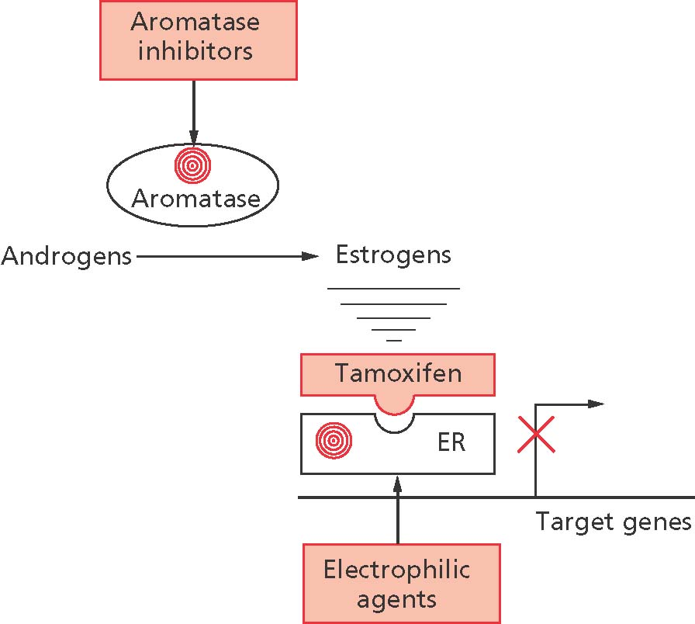
6
Blocking estrogen for breast cancer
Aromatase
inhbitors
anastrozole
exemestane
=
letrozole

Slide 16
L-asparaginase for leukemia treatment
Leukemia cells cannot synthesize asparagine.
If they are deprived of this amino acid, they will die
Administration of L-asparginase deprives
leukemia cells of asparagine:
L-asparaginase
Asn
Asp
Notes:
Good transition to personalized medicine - leukemia (specific type of cancer) has asparagine defect, suggesting molecular-level intervention
L-asparaginase catalyzes hydrolysis of asparagine to aspartic acid
Source: E coli
Need asp synthetase to make asparagine from aspartate and glutamine, leukemia cells don’t have it, rely on circulating asparagine
Can be administered subcutaneously, intramuscularly, intravenously, no tissue irritation

Slide 17
Cellular targets and personalized medicine
Possible personalized targets:
translocations, specific mutations, elevated protein levels
For an excellent review on targeted therapies, see:
Papadopoulos et al., Nat. Biotechnol. 2006, 24, 985
Bcr-Abl inhibition
EGFR inhibition
Gleevec (imatinib)
Erbitux (cetuximab)**
Tarceva (erlotinib)
Anti-angiogenic
Iressa (gefitinib)
Avastin**
Herceptin (trastuzumab)**
Thalidomide
** = antibody

Slide 18
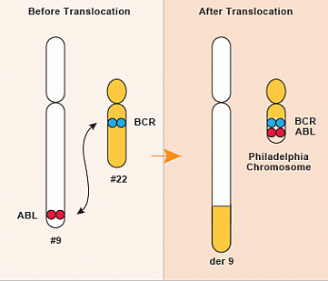
Targeted therapies: translocations
Translocation: abnormality caused by rearrangement
of parts between nonhomologous chromosomes
Goal: Move away from general cytotoxins, towards
examination of exact molecular defects in cancer cells
Gleevec: approved for Chronic Myeloid Leukemia (CML)
“Philadelphia chromosome”
(discovered at institutions in that city)
has Bcr-Abl fusion protein
BCR = breakpoint cluster region
Abl = tyrosine kinase (“Abelson”)
Notes:
The fusion gene that results from translocation codes for a tyrosine kinase signaling protein that is always on – unregulated cell division
95% of people with CML have this abnormality
Photoaffinity probe for active Abl kinase: Deng-ChemBioChem-2012-13-2510.pdf
Philadelphia Chromosome book (author Jessica Wapner, publisher The Experiment, May 2013): http://www.amazon.com/The-Philadelphia-Chromosome-Mutant-Genetic/dp/1615190678
(book cover may be useful to show during class)
Gleevec - Novartis

Slide 19
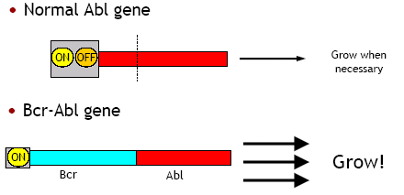
Bcr-Abl fusion leads to aberrant growth

Slide 20
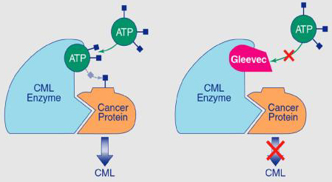
Gleevec’s mode of action
• ~85% of CML patients have bcr-abl translocation
(so, is this truly “personalized”?)
• Gleevec is a “dirty” kinase inhibitor; knocks down alternate signaling pathways that can be activated in relapse (this is a good thing for treating cancer)
Notes:
“Personalized” medicine: selecting a compound/treatment based on knowing something about the precise molecular defect in the cell/disease one is trying to treat (PJH definition) - see also Slide 2 and notes

Slide 21
Targeted therapies: anti-angiogenic
Angiogenesis is important for metastasis
Angiogenesis is rare in normal adult cells
∴ potential for selectivity against cancer cells
Strategy: block VEGF
Avastin is an antibody that binds to VEGF
Strategy: administer anti-angiogenic compounds
Thalidomide potently inhibits new blood vessel growth
• Many mechanisms for thalidomide action have been proposed
• Thalidomide causes birth defects
• Thalidomide racemizes in vivo
• The S enantiomer is teratogenic
FDA-approved in 2006 for multiple myeloma, in combination with dexamethasone (glucocorticoid steroid)
Notes:
VEGF – vascular endothelial growth factor, stimulates angiogenesis, overexpression increases blood supply in cancer (60% of tumors)

Slide 22
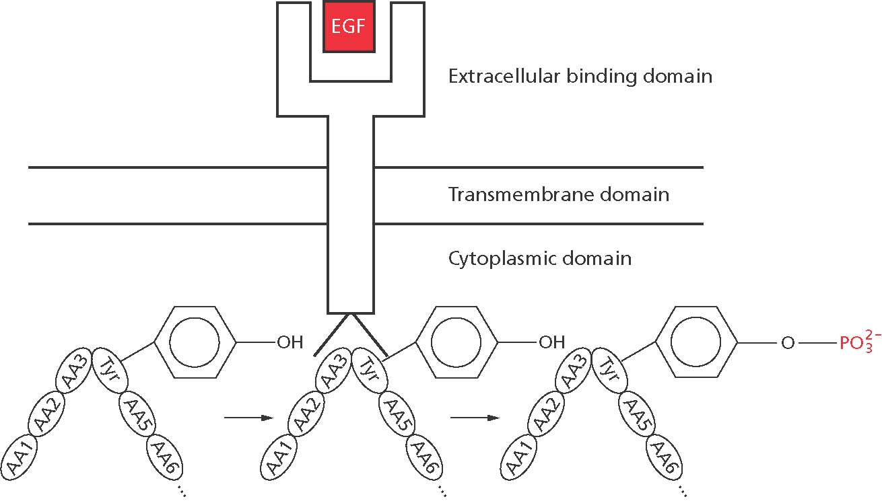
Targeted therapies: EGFR inhibition
Epidermal Growth Factor Receptor (EGFR)
is the receptor for Epidermal Growth Factor (EGF)
Upon binding EGF, EGFR initiates cell proliferation
There are 4 such receptors, all closely related tyrosine kinases:
• EGFR (HER1)
• HER2
• HER3
• HER4
Notes:
Human epidermal growth factor

Slide 23
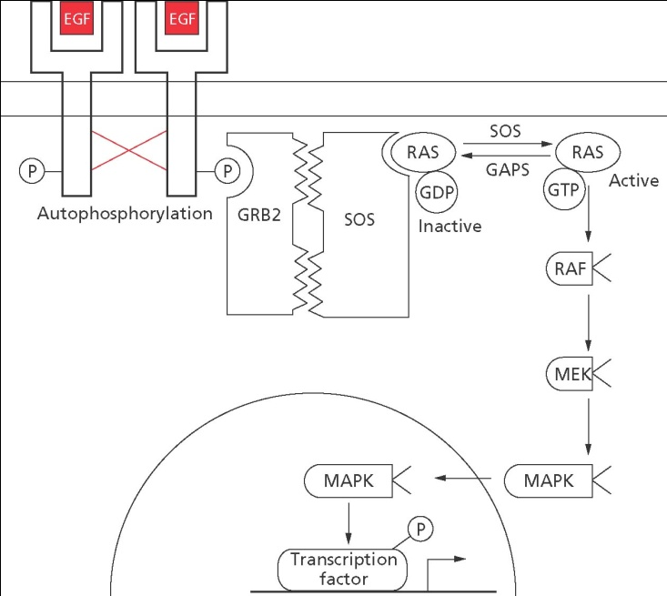
Targeted therapies: EGFR inhibition
Mutations in EGFR lead to
its overexpression and/or
overactivation...
Unrestricted growth = cancer
Papadopoulos et al., Nat. Biotechnol. 2006, 24, 985

Slide 24
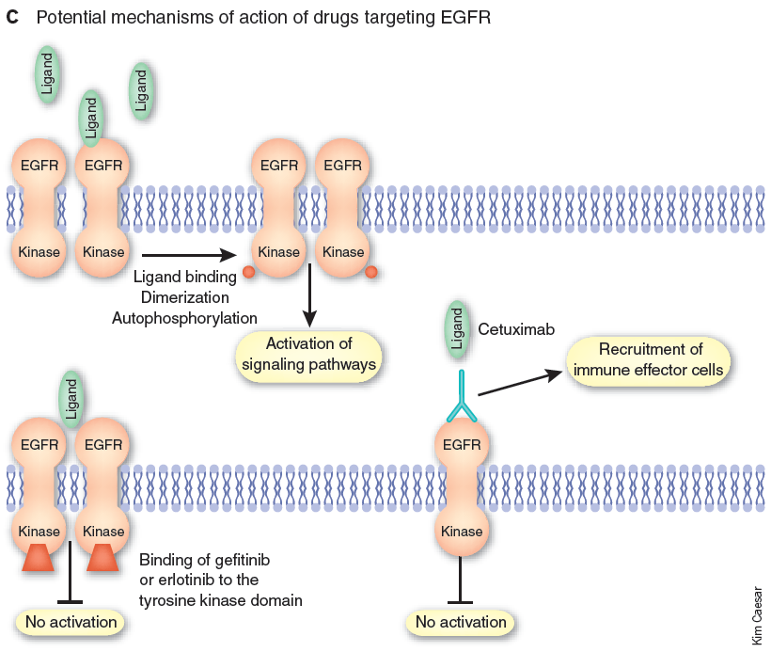
Targeted therapies: EGFR inhibition
Papadopoulos et al., Nat. Biotechnol. 2006, 24, 985

Slide 25
Herceptin as a personalized therapeutic
Trastuzumab (Herceptin) is a humanized monoclonal antibody used to treat Her2-positive breast cancers
• Assays used for direct detection of Her2 overexpression
(e.g., fluorescence in situ hybridization = FISH)
• Her2 overexpression in 20–30% of invasive carcinomas
• Subset of responsive patients are identified before treatment
At least five different mechanisms of action
for Herceptin have been proposed
• May block normal HER2 cleavage → activity suppressed
• May bind to a HER2 domain → activity suppressed
• May prevent HER2 dimerization → signaling blocked
• May recruit immune system machinery → cell death
• May induce receptor endocytosis → HER2 degradation
Hudis, N. Engl. J. Med. 2007, 357, 39
Notes:
"HER2 cleavage": extracellular domain (ECD) cleavage normally part of HER2 action
Herceptin - Genentech

Slide 26
Gefitinib (Iressa) is specific for an EGFR mutant
• EGFR inhibitor
• FDA-approved as 2nd/3rd-line treatment for non-small cell (most common) lung cancer
• Large trial showed little survival benefit
• However, in 2004, found that patients with specific EGFR mutations respond well
Various mutations (including L858R) result in conformational changes of EGFR that increase the sensitivity to inhibitors
cell line has
L858R mutation
Paez et al., Science 2004, 304, 1497
Lynch et al., N. Engl. J. Med. 2004, 350, 2129
Notes:
Iressa - AstraZeneca

Slide 27
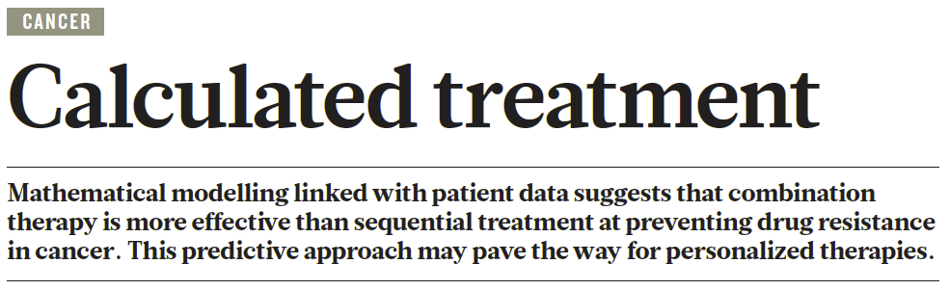
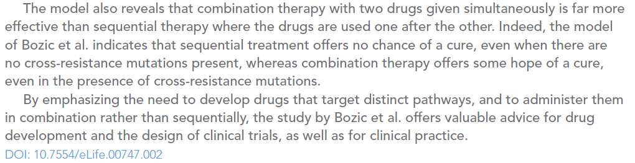
Combination therapy to suppress evolution
of drug resistance
Komarova & Boland, Nature 2013, 499, 291
Bozic et al., eLIFE 2013, 2, e00747
Notes:
combination therapy to suppress evol of resistance: Komarova-Nat-2013-499-291 (commentary); Bozic-eLIFE-2013-2-e00747 (manuscript)
also: Wadman-Nat-2012-490-15 - new cures sought from old drugs

