Slide 1
CHEM 570, Fall 2017
Concepts in Chemical Biology
Lecture 15
Activity-based protein profiling

Slide 2
Profiling
Profiling methods survey the entire contents of the cell, to determine the relative levels of key biomolecules
• DNA
• RNA
• Proteins
• Small-molecule metabolites
Profiling techniques seek to address questions by examining the cell as a whole, rather than as components
Applications in the following:
• Understanding of cellular physiology
• Detection of disease biomarkers

Slide 3
Profiling methods
How does one determine the levels of the following?
DNA
PCR; microarrays
RNA
RT-PCR; microarrays
Proteins
2D gel electrophoresis; Western blot
Small-molecule metabolites
LC-MS
What about functional activity?
Functional activity is generally inferred
from transcript/protein levels
Notes:
breast cancer and estrogen receptor (ER)+ tumors - not always responsive to endocrine therapy, because ER+ = presence of ER, but may not be functional ER

Slide 4
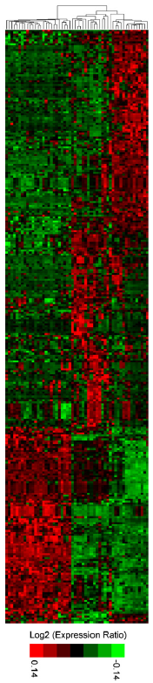
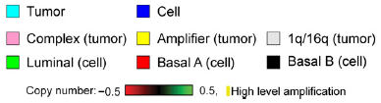
DNA/RNA profiling in action
Comparing 51 breast cancer cell lines
with 145 primary breast tumors
Transcriptional
profiling
cell lines overrepresented in “amplifier” phenotype
Genomic profiling
(clustering of genome aberrations)
upreg
dn
Neve et al., Cancer Cell 2006, 10, 515
Notes:
Note opposite red/green conventions (down/up versus up/down) for two profiling images — annoying

Slide 5
Transcript/protein levels may not correlate with activity
Enzyme function can be regulated at many levels
Expression as an inactive zymogen (proenzyme) or
bound by endogenous inhibitors
• Metalloproteases are produced as inactive proenzymes and
inhibited further by TIMPs (Tissue Inhibitors of Metalloproteases)
Post-translational modifications
• Kinase activity is itself regulated by phosphorylation events
Cofactor requirements
• NADH/NADPH is often required for redox function
Accessory proteins modulate function
• Histone deacetylase (HDAC) is active only when part of large
multi-subunit complex
Just because the gene, mRNA, or protein is present,
does not mean that the protein is functional
Notes:
Or, protein can simply be misfolded (although there are degradation mechanisms)

Slide 6
Activity-Based Protein Profiling (ABPP)
for comparative proteomics
ABPP: Uses chemical probes for profiling
enzyme function directly from a complex proteome
binding + reactive group
analytical handle
(1) binding group to bias proteome labeling;
(2) Moderately reactive moiety to covalently modify active sites
for visualization:
fluorescent tag
for enrichment:
biotin
Chemical reactivity → level of enzyme function (activity)
Chemical reactivity determines levels of activity
Evans & Cravatt, Chem. Rev. 2006, 106, 3279
Barglow & Cravatt, Nat. Methods 2007, 4, 822
Notes:
Both analytical and organic chemistry

Slide 7
What does ABPP enable?
Capture of functional information about the proteome
• Enzymes with established activities
• Enzymes with previously uncharacterized functions
Identification of selective inhibitors
(ABPP = screening platform)
Identification of conserved catalytic residues
in enzyme active site
(by mass spectrometry)

Slide 8
Types of activity-based probes
Directed probes: biased for enzymes with shared mechanism
• Serine hydrolases
• Ubiquitin hydrolases
• Proteasome
• Cysteine proteases
• Metalloproteases
• Glycosidases
• γ-secretase
• Kinases
• Tyrosine phosphatases
• Serine/Threonine phosphatases
Discovery-based probes: diverse libraries of electrophiles
• Oxidoreductases
• Glutathione S-transferases
• Enoyl-CoA hydratases
• Hydroxypyruvate reductase

Slide 9
Design strategies for ABPP probes
(1) Mechanism-based probes
• Incorporate direct knowledge of enzyme mechanism
• Must append analytical tag
(2) Probes by modification of covalent inhibitors
• Derived from known compounds that inhibit enzymes
by covalent modification
• Must append analytical tag
(3) Probes by modification of reversible inhibitors
• Derived from known compounds that inhibit enzymes
by reversible modification
• Must append analytical tag
• Must append covalent crosslinking reagent

Slide 10
ABPP probe design: mechanism-based
Serine hydrolase enzymes (peptide bond hydrolysis)
• Comprise ~1% of the mammalian proteome
• Play important roles in inflammation, angiogenesis, cancer, diabetes, and neuronal plasticity
acyl-enzyme intermediate
Ser
Asp
His
ABPP probes can be designed rationally
on the basis of the enzyme mechanism
Evans & Cravatt, Chem. Rev. 2006, 106, 3279

Slide 11
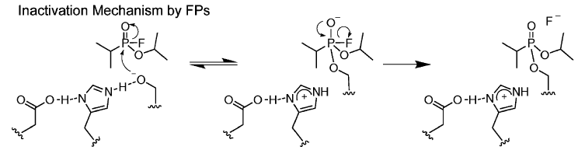
ABPP probe design: mechanism-based
Serine hydrolase enzymes (peptide bond hydrolysis)
inactivated
enzyme
fluoro-
phosphonate
(Ser probably not fully O–)
substrate mimetic groups
broad spectrum reactivity
rhodamine
(for visualization)
biotin
Evans & Cravatt, Chem. Rev. 2006, 106, 3279
Notes:
Lower right example (IEPD sequence in probe) is from Mahrus-ChemBiol-2005-12-567

Slide 12
ABPP probe design:
protein-reactive natural products
Wortmannin-based probes for lipid and protein kinases
fungal metabolite; covalently labels kinases of the phosphoinositide-3-kinase (PI3K) family by targeting a conserved lysine in the nucleotide-binding domain
Lys
ABPs based on wortmannin by minor covalent modification
Evans & Cravatt, Chem. Rev. 2006, 106, 3279

Slide 13
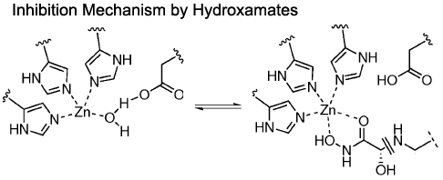
General ABPP probe design strategy
What if the enzyme mechanism is unknown,
and there are no covalent inhibitors?
Example: metalloproteases
peptide bond cleaved without any covalent bond formed to enzyme!
Hydroxamates inhibit metalloproteases by chelating Zn²⁺
Evans & Cravatt, Chem. Rev. 2006, 106, 3279
Notes:
Use of hydroxamate isn’t “mechanism-based” in terms of metalloprotease; just uses unrelated knowledge that hydroxamates bind Zn2+, and is known that metalloproteases require Zn2+ (even without knowing their mechanism)

Slide 14
General ABPP probe design strategy
Create ABPP probe by appending a
benzophenone group onto a hydroxamate inhibitor
General strategy: elaborate an existing inhibitor to include both an analytical tag and a covalent crosslinking group
Notes:
Contrast to Slide 11: there, binding and reactive groups are the same thing (fluorophosphonate); here, binding = hydroxamate, reactive = benzophenone

Slide 15
ABPP in action: example using serine hydrolases
Serine hydrolase enzymes (peptide bond hydrolysis)
• Comprise ~1% of the mammalian proteome
• Play important roles in inflammation, angiogenesis, cancer, diabetes, and neuronal plasticity
Hypothesis: Because of the diverse functions of serine hydrolases, profiling may provide sufficient information to differentiate cellular disease states
broad spectrum reactivity
Broadly reactive fluorophosphonate ABPP probe,
fluorescently labeled
rhodamine
(for visualization)
Jessani et al., Proc. Natl. Acad. Sci. USA 2002, 99, 10335

Slide 16
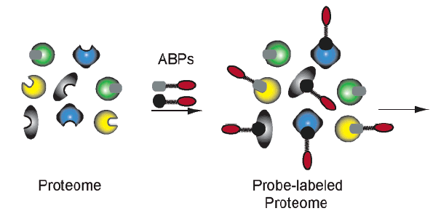
ABPP in action: example using serine hydrolases
Experimental procedure:
• Obtained cancer cell lines of varying origin (melanoma, breast, ovarian) and phenotype (aggressive vs. nonaggressive)
• Separated cell lines into their secreted, soluble, and membrane proteome fractions
SDS-PAGE
(Just one ABP used in this experiment)
Jessani et al., Proc. Natl. Acad. Sci. USA 2002, 99, 10335

Slide 17
ABPP & serine hydrolases: secreted proteome
deglycosylation
∗
∗
In-gel
fluorescence
analysis
Secreted enzyme activities differed among human cancer lines
Certain serine hydrolases = markers for cells of melanoma origin?
Jessani et al., Proc. Natl. Acad. Sci. USA 2002, 99, 10335

Slide 18
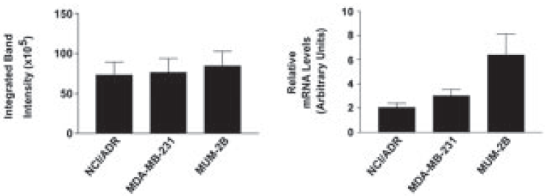
ABPP & serine hydrolases: secreted proteome
Urokinase:
• serine protease
• established marker of human cancer progression in vivo
• activity regulated by processing and interactions
Level of
active urokinase as measured by ABPP
Urokinase mRNA levels (Northern blot)
∗
∗
(MUM-2B = highly invasive melanoma cell line)
Clear example of mRNA levels not correlating well
with actual protein activity
Jessani et al., Proc. Natl. Acad. Sci. USA 2002, 99, 10335

Slide 19
ABPP & serine hydrolases: membrane proteome
FAAH (fatty acid amide hydrolase) detected
only in poorly invasive breast cancer cell lines
Jessani et al., Proc. Natl. Acad. Sci. USA 2002, 99, 10335

Slide 20
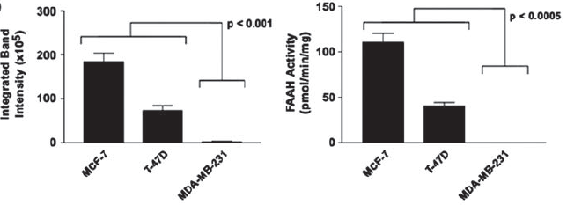
ABPP & serine hydrolases: membrane proteome
ABPP labeling of FAAH correlates well with FAAH activity
FAAH levels from ABPP
FAAH activities from substrate assays
Back-calculating from the known k_{cat} of FAAH,
~600 pg of active protein was labeled
(<0.0005% = 5 × 10^{–6} of the total cell proteome)
ABPP can accurately detect low levels of activity
Jessani et al., Proc. Natl. Acad. Sci. USA 2002, 99, 10335

Slide 21
A protein of unknown function is elevated
in aggressive cancers
Jessani et al., Proc. Natl. Acad. Sci. USA 2002, 99, 10335
Notes:
KIAA1363 = integral membrane hydrolase of unknown function

Slide 22
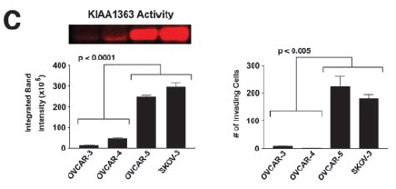
A protein of unknown function is elevated
in aggressive cancers
ABPP level
cancer cell invasiveness
KIAA1363 activity may serve as a new marker
of tumor progression or as a new molecular target
Jessani et al., Proc. Natl. Acad. Sci. USA 2002, 99, 10335
Notes:
The "target" possibility would require that KIAA1363 is not only correlating with tumor progression, but actually causing tumor growth (if not causing, then targeting will be ineffective)

Slide 23
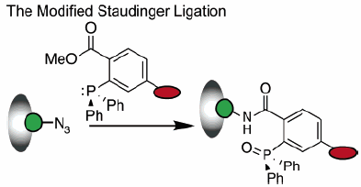
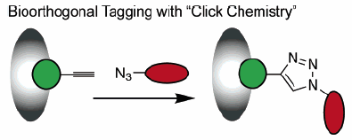
“Tag-free” strategies for ABPP
One drawback to common ABPP probes
is the use of large analytical tags
(may alter solubility and impede efficient labeling)
Seeking bioorthogonal ABPP probes:
Use very small tag, then modify tag after ABPP reaction
(A tag is still used; it’s just very small!)
Speers & Cravatt, Chem. Biol. 2004, 11, 535 (click chemistry ABPP)
Verdoes et al., ChemBioChem 2008, 9, 1735 (Staudinger ligation ABPP)

Slide 24
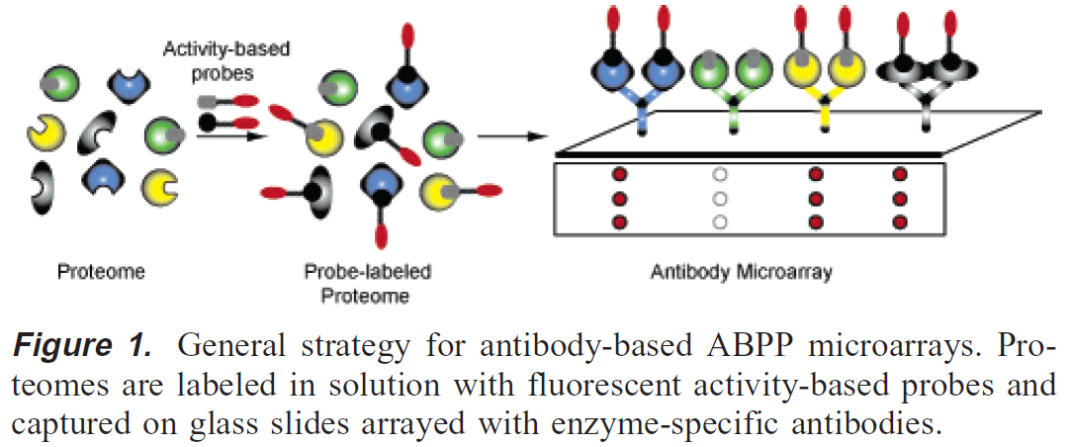
Gel-free strategies for ABPP
Limitations of 1D gel electrophoresis:
• Time-consuming (protein identification = slow step)
• Limited resolution (~15 proteins/gel)
• Limited sensitivity (~15 µg of protein/gel)
ABPP antibody microarrays
Advantages:
• Selective profiling
(antibodies)
• Increased sensitivity
(microarrays)
• Small sample needs
(microarrays)
Sieber et al., J. Am. Chem. Soc. 2004, 126, 15640

Slide 25
Gel-free strategies for ABPP:
ABPP antibody microarrays
Advantages:
• 30+-fold greater
sensitivity
• 10× less protein
per experiment
Sieber et al., J. Am. Chem. Soc. 2004, 126, 15640

Slide 26
ABPP-MudPIT
Need to address the problems of protein throughput and identification, ideally in unbiased fashion
Multidimensional Protein Identification Technology (MudPIT)
Strong cation-
exchange column
Lys-C/trypsin
digest
of proteome
Reverse-phase column
MS/MS
Washburn et al., Nat. Biotechnol. 2001, 19, 242
Notes:
ABPP-MudPIT takes MudPIT and interfaces with ABPP, such that the "proteome" being analyzed is only a subset of the whole proteome (via activity-based labeling)

Slide 27
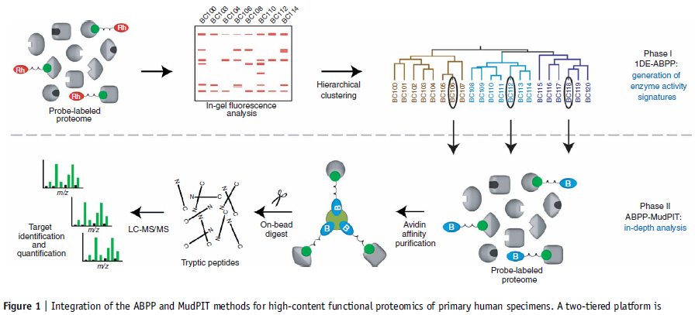
ABPP-MudPIT
Jessani et al., Nat. Methods 2005, 2, 691

Slide 28
ABPP-MudPIT
Advantages:
• High information content (e.g., use of fluorophosphonate
probes → identification of >50 serine hydrolases from
membrane proteome)
• Good quantification (relative enzyme activities, e.g. from
invasive vs. noninvasive tumors, is accomplished by
comparing MS peak intensities)
Disadvantage:
• Requires large sample quantity (~750 µg/experiment)
Jessani et al., Nat. Methods 2005, 2, 691

Slide 29
ABPP beyond comparative proteomics: inhibitor discovery
Individual ABPP probes:
profile enzymes with similar mechanisms
Competition experiments between ABPP probes and small-molecule inhibitors can provide insight into selectivity and potency
Leung et al., Nat. Biotechnol. 2003, 21, 687

Slide 30
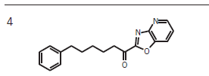
ABPP beyond comparative proteomics: inhibitor discovery
Recall from Slide 22: KIAA1363 activity may serve as a new marker of tumor progression or as a new molecular target
∗
∗
compound #
FAAH
KIAA1363
ABPP permits the identification of inhibitors for both
(i) enzymes with diverse substrates preferences (FAAH)
and (ii) novel enzymes that lack known substrates (KIAA1363)
Leung et al., Nat. Biotechnol. 2003, 21, 687
Notes:
Rather low-throughput screen

Slide 31
ABPP beyond comparative proteomics: determining functional roles of proteins
What does KIAA1363 do?
IC₅₀
150 nM
Chiang et al., Chem. Biol. 2006, 13, 1041

