Slide 1
CHEM 570, Fall 2017
Concepts in Chemical Biology
Lecture 7
Methods for characterizing
biomolecular interactions
Facile chemical reactions
for bioconjugation

Slide 2
Overview of methods for characterizing biomolecular interactions
What types of interactions do we want to study?
• Protein-protein
• Protein-small molecule
• Protein-DNA
• DNA-small-molecule
• ...
In vitro experiments to determine strength of an interaction
Why do we want to study these interactions?
• Understand fundamental biology
• Quantitation → optimization of function
What are the best methods and techniques for this work?
• Methods that require a “label”
• Methods that are “label-free”
label
label-free

Slide 3
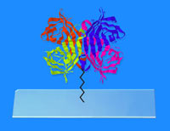
Biotin-streptavidin interaction:
Commonly used throughout chemical biology
biotin (vitamin H, vitamin B7):
CO₂ carrier in carboxylations
streptavidin
K_{d} ~10^{–14} M = 10 fM
One of the strongest noncovalent interactions known
• Streptavidin (and related proteins) are readily immobilized and derivatized, enabling a wide variety of assays
• Biotin can be attached to many types of molecules

Slide 4
Spectroscopic methods
label
Fluorescence perturbation
macromolecule
+
ligand
(only one
fluorophore
at a time!)
Fluorophore on ligand
• Fluorescence intensity changes upon binding
Fluorophore on macromolecule
• Fluorescence intensity changes upon binding
• Fluorophore is often Trp of protein

Slide 5
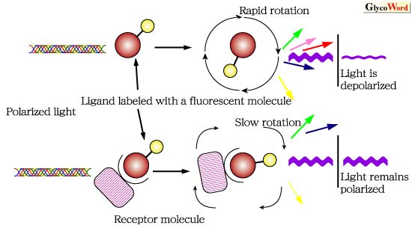
Spectroscopic methods
label
Fluorescence polarization (fluorescence anisotropy)
plane-polarized
light
• Rapid rotation of free, labeled ligand → loss of polarization
• Binding of ligand to macromolecule → much slower tumbling; much less loss of polarization

Slide 6
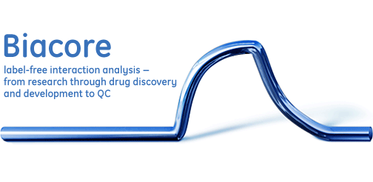

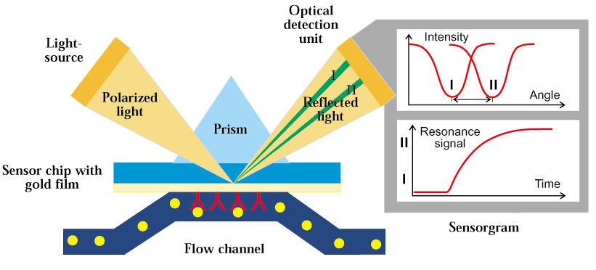
label-free
Surface Plasmon Resonance (SPR)
(usually)
• General analytical method
• Immobilized ligand on surface
• Injected protein analyte passes over sensor surface
• Accumulating protein changes resonance characteristics
Biacore 3000 in UIUC Keck Ctr.

Slide 7
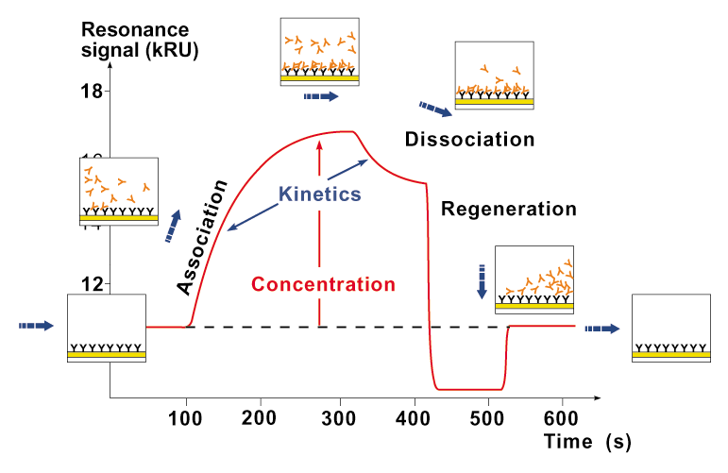
label-free
Surface Plasmon Resonance (SPR)
(usually)

Slide 8
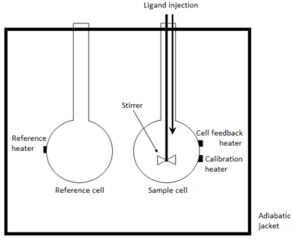
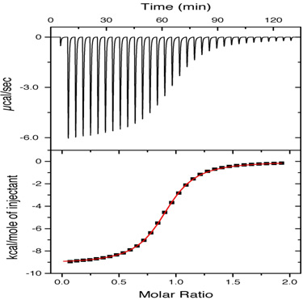
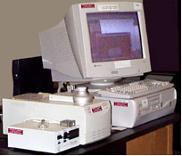
label-free
Isothermal Titration Calorimetry (ITC)
• Heat evolved or absorbed when two molecules interact
• Titrate ligand into sample cell
• Measure power needed to maintain reference cell at same temperature as sample cell
• K_{d}, ΔG, ΔH, ΔS
integrating area of each peak → H
cumulative total of H
(exothermic reaction)
Microcal ITC in SCS facility

Slide 9
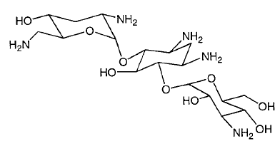


Mass spectrometry
label-free
In some cases,
noncovalent complexes can be detected using electrospray ionization mass spectrometry (ESI-MS)
(aminoglycoside antibiotic)
Sannes-Lowery et al., Anal. Biochem. 2000, 280, 264

Slide 10
Nuclear Magnetic Resonance (NMR)
label
(usually)
NMR has a strong history in study of biomolecular interactions, especially for drug discovery
• Ligands for subsites identified by NMR (chemical shift changes in ¹⁵N-HSQC spectra)
• Analogues screened to optimize binding
• Ligands linked on basis of X-ray or NMR info
Science 1996, 274, 1531
Approach used to identify nM binders to FK506 binding protein (FKBP)
FK506 (immunosuppressant)
Notes:
Fragment-based approach to be discussed again in Lecture 18
Heteronuclear single quantum coherence (HSQC) experiment - can use natural abundance 15N, but may benefit from isotopic labeling - correlate amide NH proton and N atom

Slide 11
Nuclear Magnetic Resonance (NMR)
label
(usually)
“SAR by NMR” has had other successes, such as in development of inhibitors for proteins that are regulators of apoptosis.
Oltersdorf et al.,
Nature 2005, 435, 677
orange = NMR-based screening leads
green = peptide derived from Bak, a pro-apoptotic protein
However, SAR-by-NMR approaches have not always worked well, due in part to inattention to issues of dynamics

Slide 12
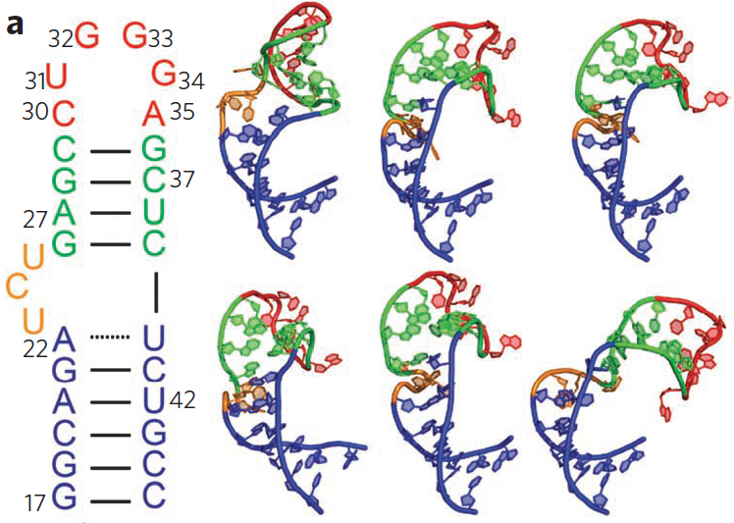
Nuclear Magnetic Resonance (NMR)
label
(usually)
RNA is a validated biological target, but RNA dynamics make SAR-by-NMR difficult to perform.
• Conformations of HIV-1 TAR RNA used for virtual screening
• Identified multiple small molecules that bind TAR with high affinity (K_{i} as low as 710 nM for Tat peptide interaction)
Accounting for dynamics is very important
Stelzer et al., Nat. Chem. Biol. 2011, 7, 553
More on NMR and drug discovery
http://www.bioc.aecom.yu.edu/labs/girvlab/nmr/course/COURSE_2007/Lecture_Drug_Discovery.pdf
http://tesla.ccrc.uga.edu/courses/bionmr

Slide 13
Identifying the compound binding site
• X-ray crystallography
• NMR
• Displacement with ligand that has known binding site
• ... ?
Suppose that none of these methods are feasible...
What else can be done?

Slide 14
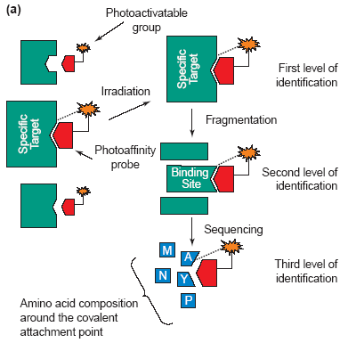
Photoaffinity labeling
A new covalent linkage is created between the macromolecule and a light-sensitive detectable ligand
∗
Light (hν) →
irreversible linkage
between ligand
and macromolecule
Many different chemical approaches can be taken to photoaffinity labeling
Dormán & Prestwich, TIBTECH 2000, 18, 64

Slide 15
Design of photoaffinity probes
First, need to know structure-activity relationship (SAR):
Where can we modify ligand without losing activity?
Once the site of ligand modification is selected,
then the photoprobe itself must be chosen.
Key considerations:
1. Synthetic accessibility
2. Stability to ambient light
3. Useful activation λ_{max} to avoid protein interference (>300 nm)
4. Photochemical excited state with useful half-life (t_{1/2})
5. Known photochemistry with useful product formation
6. Reactivity with C–H and X–H bonds

Slide 16
Commonly used photoaffinity probes
(R = ligand)
benzophenone
aryl azide
diazirine
Each of these probes reacts via a characteristic mechanism
benzophenone
C–H insertion mechanism
(insertion into C–H bonds within ~3 Å of C=O oxygen)
excited
state
Dormán & Prestwich, TIBTECH 2000, 18, 64

Slide 17
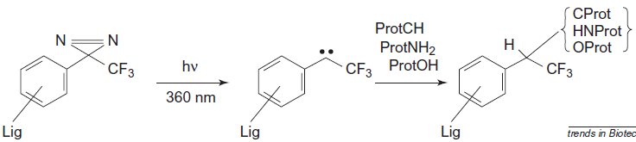
Commonly used photoaffinity probes
aryl azide
NH₂ or OH nucleophilic additions
dehydro-
azepine
singlet
triplet
C/N/O–H insertions
nitrene
diazirine
carbene
(divalent C)
C–H insertion

Slide 18
Photoaffinity probe - example
PARG = poly(ADP-ribose) glycohydrolase enzyme
• Azide analogue 2b inhibited PARG by 50% at 1 µM (80x lower concentration than 2a)
³²P
• α-³²P-radiolabeled analogue of 2b was synthesized and used as photoaffinity probe
• Photocrosslinking results were used to learn about enzyme binding sites for various ADP-ribose polymers
Here the ³²P radiolabel was used to allow visualization on PAGE. Other “handles” could include fluorophores, biotin, or reactive functional groups for later modification.
Ramsinghami et al., Biochemistry 1998, 37, 7801

Slide 19
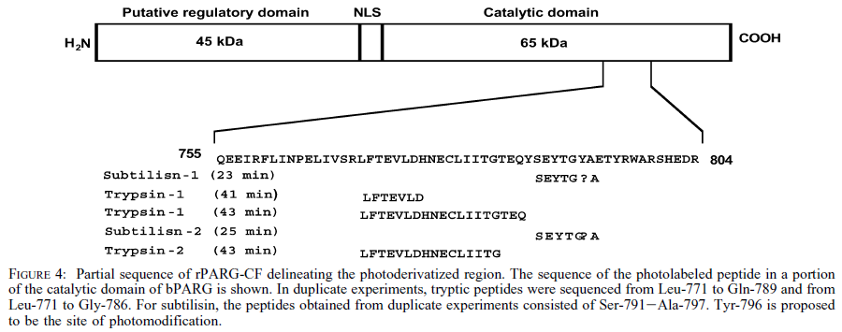
Photoaffinity probe - example
Identification of ADP-HPD binding site on PARG
Edman degradation → no id for residue at position 796
• Photocrosslinked PARG was digested with trypsin or subtilisin
→ photolabeled peptides
• Tyr796 was identified and studied via site-directed mutagenesis
• SPR was used to study wt, Y796A, and Y796W mutant enzymes
Koh et al., Biochemistry 2003, 42, 4855

Slide 20

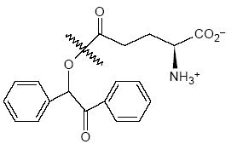
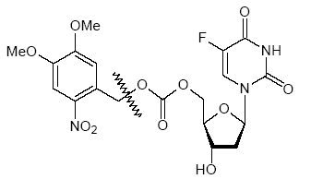
Caged compounds
• Photorelease of active compound from inactive, protected (“caged”) precursor
• Light (hν) enables both spatial and temporal control
caged Glu (benzoinyl)
caged 5FdU (nitrobenzyl, 350 nm)
See also: Yu et al., Chem. Soc. Rev. 2010, 39, 464

Slide 21
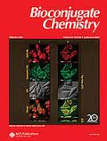
Overview of facile chemical reactions
for bioconjugation
Conjugation reactions are needed that...
• Work consistently and in high yield
• Work in aqueous solution
• Work with wide substrate scope
See previous slides for bioconjugation reactions of amines, thiols, and aldehydes/ketones
What other reactions are commonly used?

Slide 22

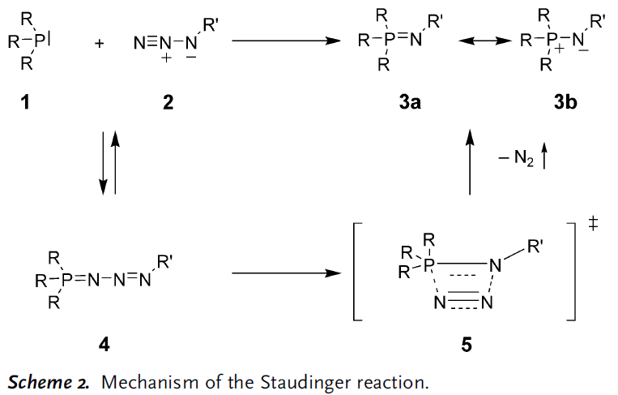
Staudinger ligation
Köhn & Breinbauer, Angew. Chem. Int. Ed. 2004, 43, 3106
Staudinger reaction: Hermann Staudinger, 1919
This N atom is highly nucleophilic!
phosphine
azide
iminophosphorane
(aza-ylide)
phosphazide
The functional groups are orthogonal to cellular components
Notes:
http://pubs.acs.org/toc/achre4/44/9 - Sept 2011 issue of Acc. Chem. Res. is on bioorthogonal chemistry (Bertozzi editorial)

Slide 23
Staudinger ligation
Staudinger reduction
aza-Wittig reaction
Clearly the Staudinger reaction and subsequent reactivity of the iminophosphorane have synthetic utility. Can this reaction be applied for chemical biology?
iminophosphorane
(aza-ylide)
Köhn & Breinbauer, Angew. Chem. Int. Ed. 2004, 43, 3106
van Berkel et al., Angew. Chem. Int. Ed. 2011, 50, 8806
Schilling et al., Chem. Soc. Rev. 2011, 40, 4840

Slide 24
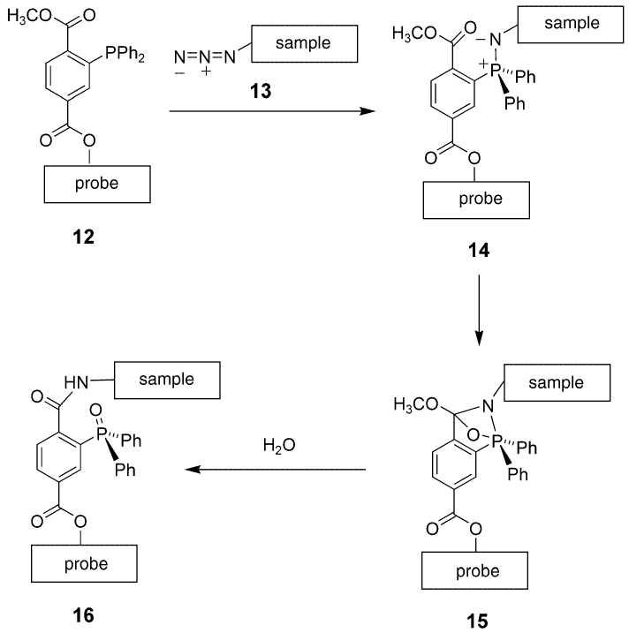
Staudinger ligation
made by
ester
formation
iminophosphorane
N is reduced
P is
oxidized

Slide 25
Staudinger ligation - “traceless” variant
iminophosphorane
good leaving groups as X–

Slide 26
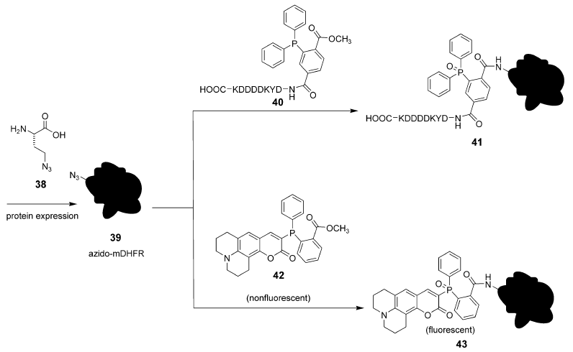
Staudinger ligation - application #1
(non-traceless)
FLAG epitope tag
(azido-homoalanine replaced Met; more on synthesis of proteins with unnatural amino acids in later lecture)
Köhn & Breinbauer, Angew. Chem. Int. Ed. 2004, 43, 3106

Slide 27
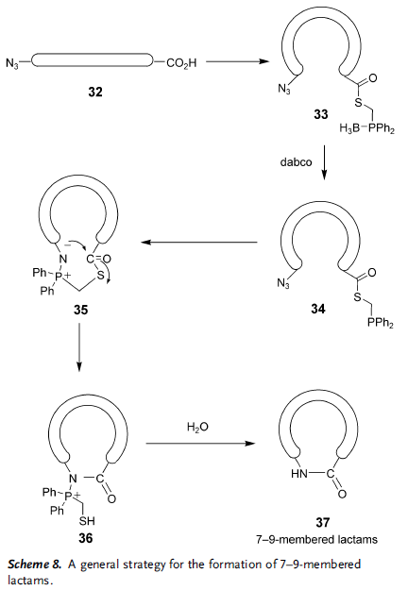
Staudinger ligation - application #2
(traceless)
borane-protected; removed by strong amine nucleophile
∗
favorable enthalpy of amide formation overcomes ring strain of forming medium-sized ring
∗

Slide 28
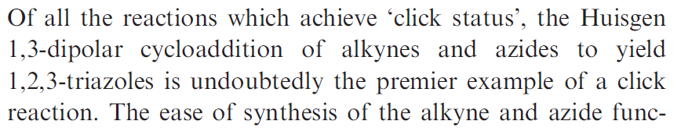
“Click chemistry”: Azide + alkyne
• Works in aqueous solution
• Quantitative yields
• Azide and alkyne functional groups are
orthogonal to nearly everything in a cell
Moses & Moorehouse, Chem. Soc. Rev. 2007, 36, 1249

Slide 29
“Click chemistry”: Azide + alkyne
Cu⁺ is undesirable in a biological system... how to avoid?
Strain-promoted azide-alkyne cycloaddition
• Strained cyclooctynes – don’t need Cu⁺ to react
• Coumarin dyes used to label newly synthesized proteins in fibroblasts
Cells remained viable,
as established with MitoTracker and other data
Beatty et al., ChemBioChem 2010, 11, 2092
Lallana et al., Angew. Chem. Int. Ed. 2011, 50, 8794
Notes:
Lee-ChemBioChem-2011-12-2120.pdf: novel fluorescent probes for mitochondrial surface
Lapinsky-BioorgMedChem-2012-20-6237.pdf: tandem photoaffinity labeling-bioorthogonal conjugation
Add new slide on Lapinsky review?

Slide 30
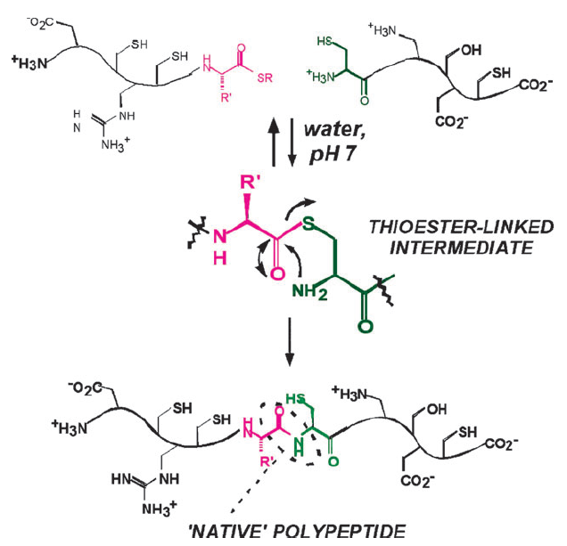
Native chemical ligation of proteins
• Convenient method for synthesizing large peptides/proteins
• Enables chemical synthesis of very long proteins, or proteins with post-translational modifications (PTMs)
C-terminal thioester
+ N-terminal Cys;
first step is reversible,
whereas second step
is irreversible
(important)
Kent, Chem. Soc. Rev. 2009, 38, 338
Many variants now widely used

