Slide 1
CHEM 570, Fall 2017
Concepts in Chemical Biology
Lecture 3
Analysis of DNA, RNA, and protein levels

Slide 2
Overview
Two types of question may be asked:
1. Is a (DNA, RNA, protein) PRESENT in the sample?
2. What is the LEVEL of a (DNA, RNA, protein) in the
sample?
As a generalization, a binary (YES/NO) answer is sufficient for DNA analysis, whereas for RNA and protein, LEVELS are needed.

Slide 3
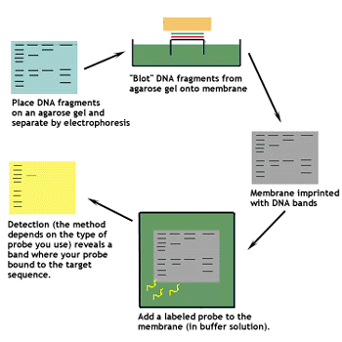
Analysis of DNA by Southern blotting
Method to determine if a certain stretch of DNA is present
DNA is first cleaved by restriction enzymes, then...
Edwin Southern
Oxford University
Southern blotting has largely been replaced by PCR analysis.

Slide 5
Nitrocellulose
Synthesis:
First human created plastic (1862)
Sticky nature exploited to immobilize nucleic acids, as well as proteins

Slide 6
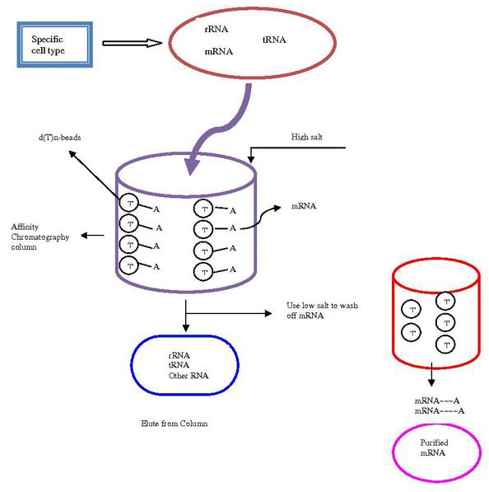
Quantifying mRNA levels
Recall: mRNAs are generally polyadenylated
mRNA is therefore isolated using a poly-T column:
• rRNA, tRNA elute with high salt
• mRNA sticks to poly-T and elutes with low salt
mRNA is then quantified by:
• Northern blot
• rtPCR

Slide 7
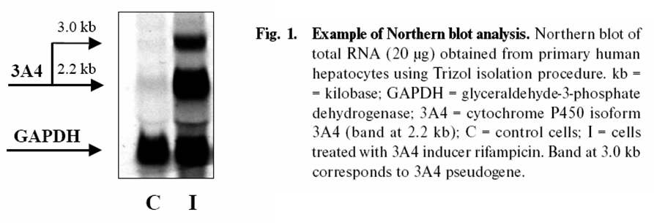
Quantifying mRNA by Northern blotting
Northern blotting is analogous to Southern blotting
• RNA is isolated and separated by electrophoresis
• Probing is done with a complementary DNA strand
• Typically the DNA strand is ³²P-radiolabeled
• Fluorescent labels are also used

Slide 8
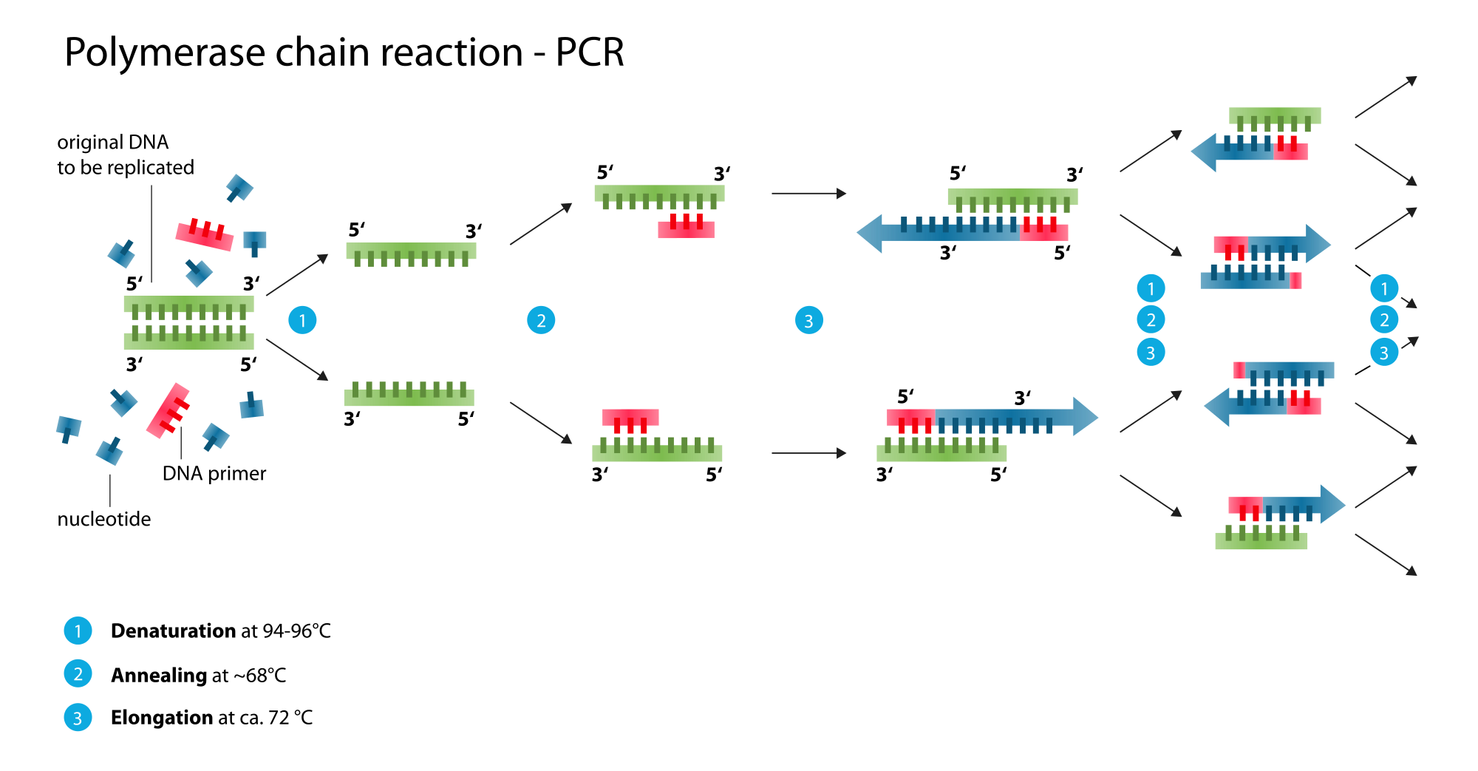
Quantifying mRNA using PCR
rtPCR = reverse transcription / PCR
Most sensitive technique for mRNA quantification
Important to remember that PCR uses double stranded DNA as the template
Q: how do we go from mRNA to DNA?
Notes:
Similar to PCR, except an extra enzyme, reverse transcriptase is used to convert mRNA into cDNA which can be read and used by taq polymerase as a template

Slide 9
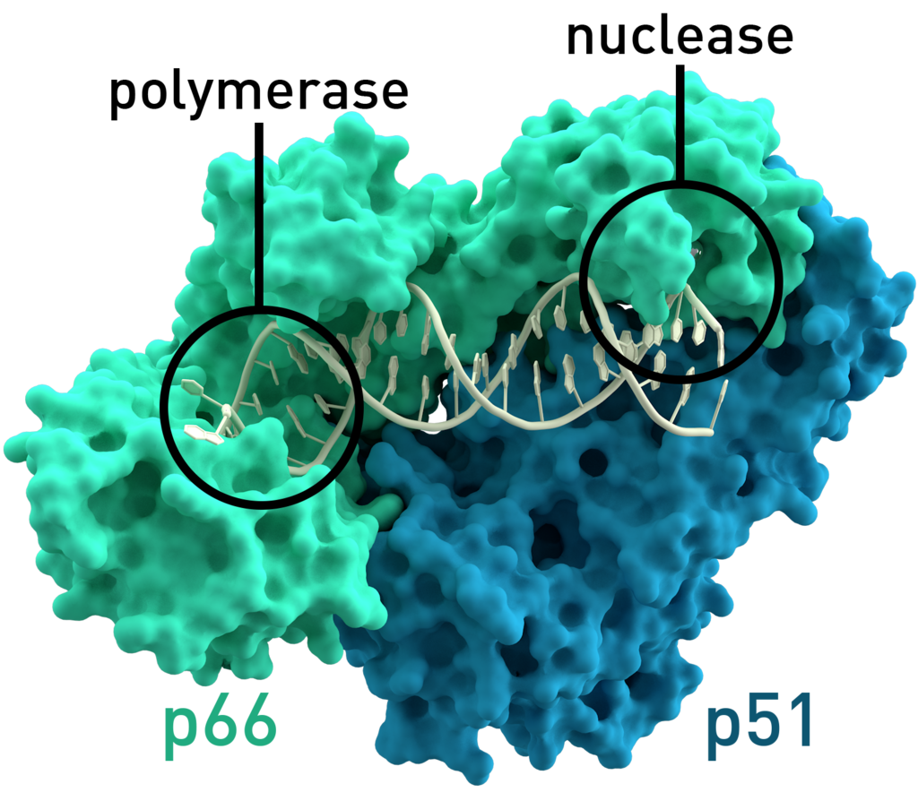
Reverse Transcriptase: mRNA → cDNA
A reverse transcriptase (RT) is an enzyme used to generate complementary DNA (cDNA) from an RNA template, a process termed reverse transcription
Enzyme mainly associated with retroviruses.
Some examples?

Slide 10
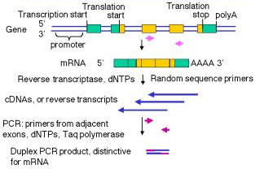
Putting it together: rtPCR to quantify mRNA
One-pot procedure: add dNTPs, primers, and enzymes
animation: http://www.bio.davidson.edu/Courses/genomics/RTPCR/RT_PCR.html

Slide 11
Utility (or not) of quantifying mRNA by rtPCR
• rtPCR uses PCR to amplify signal
• Detect low-abundance transcripts
• Ideal for end-point analysis: is mRNA present or not?
Dynamic range problem:
Various mRNA transcripts are present at levels that differ by several orders of magnitude
• At best, PCR and rtPCR are only semi-quantitative
• Amount of product correlates poorly with input DNA/RNA
PCR and rtPCR are good for binary “yes/no”
answers about the presence/absence of a DNA or RNA.
However, exact ratios of starting DNA/RNA CANNOT be
determined reliably using these methods.

Slide 12
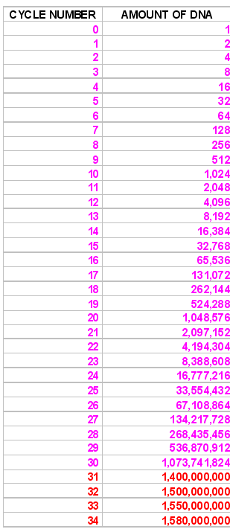
Nonlinear DNA amplification in PCR
The more template you begin with, the earlier you reach plateau phase
Monitoring amount
of DNA product
after each cycle
allows reliable quantification of amount of input DNA
plateau phase
Notes:
At the beginning, there is a large excels of regents (nts) giving use an approximate doubling of DNA after each cycle
PCR product vs # of cycles
Log phase
Linear phase
Plateau phase

Slide 13
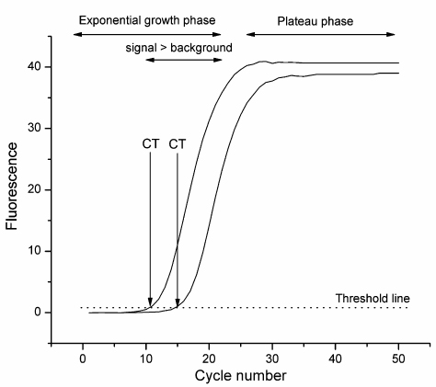
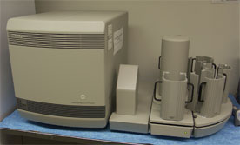
“Real-time” PCR: Amount of DNA is quantified after each PCR cycle
• Signal generated in situ by use of fluorescent dye
• SYBR Green (see Slide 1-55) is commonly used
CT value =
# cycles to reach threshold
Real-time PCR machines can thermocycle and measure fluorescence simultaneously
Taqman ABI instrument
in Keck Center
Notes:
rt = reverse transcription vs. real-time: in principle, can have rt-rtPCR, although not usually called that

Slide 14
Real-time PCR with 10-fold dilutions of template
Take a very concentrated sample and perform serial dilutions
Threshold
Can be set to tell software where to take data but must be in the Log phase
Note that all dilutions look similar in endpoint analysis
Notes:
Take a very concentrated sample and perform serial dilutions

Slide 15
Real-time PCR with 10-fold dilutions of template
Set where the precision of the replicates is the highest
Notes:
Some analogy here to initial-rate kinetics, versus fitting entire progress curve
Only data in the log phase is important for rt-PCR

Slide 16
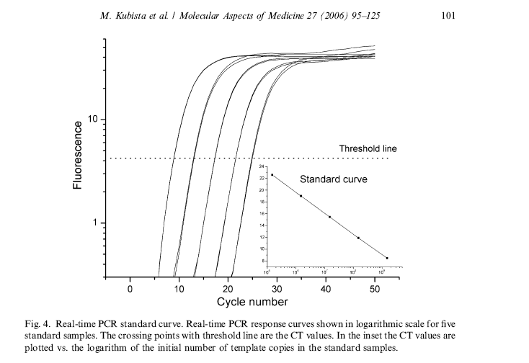
Real-time PCR: standard curve
With the standard curve, we can run our experimental sample and determine how much mRNA we had in the first place

Slide 17
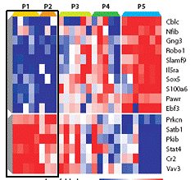
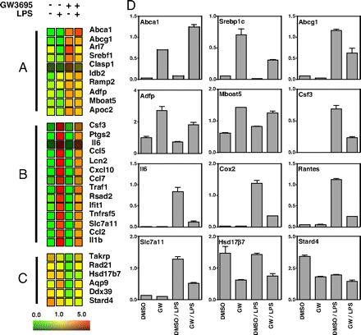
Analysis of global RNA levels:
Transcriptional (expression) profiling
Can we determine if mRNA levels are altered in a certain tissue in response to a stimuli or in a certain disease?
Transcriptional (expression) profiling:
Simultaneous determination of levels of all RNA transcripts in a sample

Slide 18
Transcriptional profiling requires
DNA microarray technology
Array: orderly arrangement of samples
Microarray: really small array (spots <200 µm diameter)
500 µm
DNA microarray: Physically matches known and unknown oligonucleotides
A single experiment can provide information on thousands of transcripts (genes) simultaneously!

Slide 19
Why use DNA microarrays?
1. Transcriptional (expression) profiling
• Global analysis of how a cell responds to a certain stimulus (e.g., drug or nutrient treatment, pH shift)
• Generally, protein levels are of major interest; however, Watson-Crick complementarity allows nucleic acids to be monitored easily
2. Genotype applications
• Direct analysis of DNA, including single-nucleotide polymorphisms (SNP detection)

Slide 20
Reminder of Central Dogma
DNA
replication
transcription
RNA
If we want to examine the levels of all proteins in the cell, it is easier to look at the mRNAs.
Drawbacks?
translation
protein
Notes:
Drawback: may not be precise correlation between mRNA and protein levels

Slide 21
What did we use before microarrays?
To determine the abundance of a single mRNA,
use Northern blotting (Slide 3-7)
incubate with
radiolabeled probe
transfer
visualize
electrophoresis
of mRNA
mRNA on
nitrocellulose

Slide 22
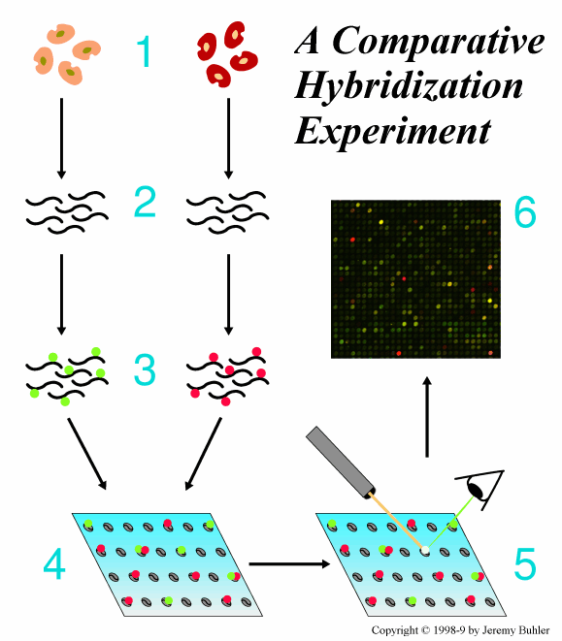
Overview of DNA microarrays
1
Cancer vs. normal
Heart vs. brain
Drug-treated vs. control
Changes in pH, nutrients,
toxins, temperature...
2
6
3
Equivalent to 10,000
simultaneous Northern
blots!
4
5

Slide 23
Overview of DNA microarrays
1. Grow cells; construct or purchase array
A) Where does one get the DNA?
B) How does one make a microarray?
animation: http://www.bio.davidson.edu/courses/genomics/chip/chip.html

Slide 24
Overview of DNA microarrays
2. Obtain mRNA from treated and non-treated cells
Note that everything in these experiments is relative.
C) How is the mRNA isolated?

Slide 25
Overview of DNA microarrays
3. Reverse-transcribe mRNA ® cDNA, in labeled form
reverse
transcriptase
mRNA cDNA
D) Why not use the mRNA directly?
E) How are the cDNA samples labeled?

Slide 26
Overview of DNA microarrays
4. Apply labeled cDNA samples to prefabricated DNA array

Slide 27
Overview of DNA microarrays
5 & 6. Scan slides and analyze data
F) How expensive is
this instrumentation?
G) Can I do these experiments here at Illinois?

Slide 28
A) Where does one get the DNA?
There are several types of microarrays:
1. Immobilized cDNA
• Actual full-length gene
• PCR-amplified from appropriate vector
• Spotted onto poly-Lys slides
2. Immobilized oligonucleotides
• 40 to 80 nucleotides (nt) in length
• Can be synthesized on slides, or spotted onto slides
3. Hexamer-based “universal arrays”
• All possible 4⁶ = 4096 DNA hexamers
• Obviates need for organism-specific probes
Nat. Biotechnol. 2004, 22, 418

Slide 29
B) How does one make a microarray?

Slide 30
Microarraying robots
Robot will deliver ~1 nL/spot
Spots are 50–200 µm in size
>10,000 spots per slide

Slide 31
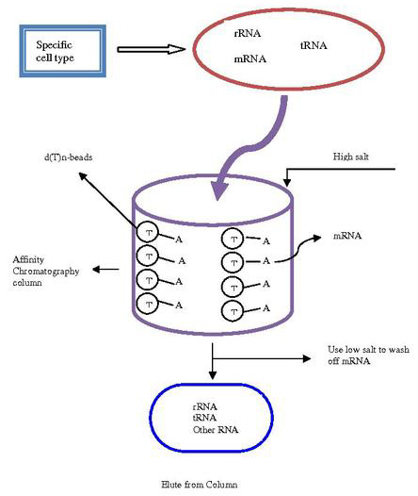
C) How is the mRNA isolated?
• Most mRNAs have poly-A tail
• Isolated via poly-T column
• See Slide 3-6 for reminder
D) Why not use the mRNA directly?

Slide 32
E) How are cDNA samples labeled?
reverse
transcriptase
mRNA cDNA
1) Incorporate fluorescent nucleotide conjugates during RT
• bulky substrates = less efficient incorporation
• expensive ($$$)
2) Incorporate functionalizable nucleotide during RT
• incorporate primary amino group (–NH₂)
• modify after cDNA after RT with fluorophore

Slide 33
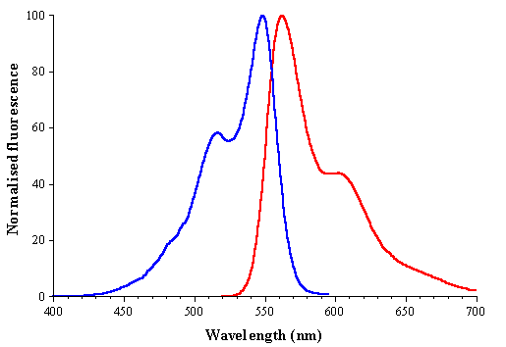
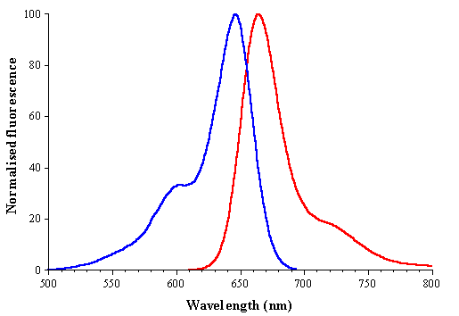
Commonly used fluorophores: cyanine (Cy) dyes
Cy3
Cy5
excitation
emission

Slide 34
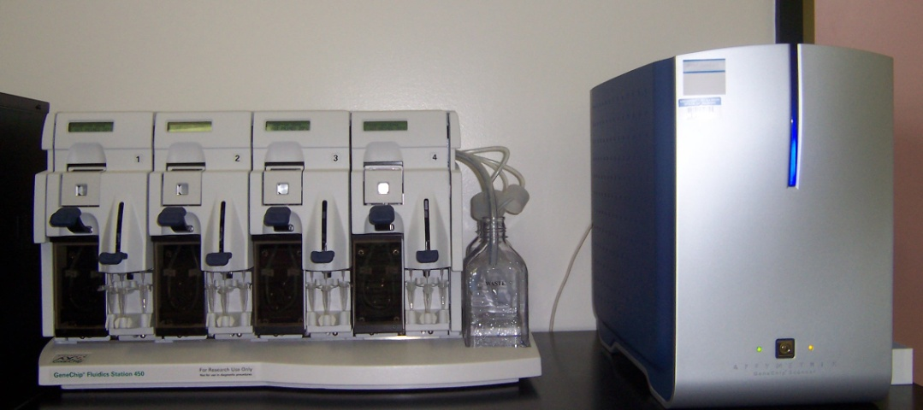
F) How expensive is this instrumentation?
G) Can I do these experiments at Illinois?
Microarrayer = $50,000
Slide scanner = $50,000
The Keck center at Illinois has an arrayer.
They sell pre-made arrays, or you can bring cDNA
to them and they will make an array for you.
http://www.biotech.illinois.edu/centers/Keck/Functional_genomics/affymtx.htm

Slide 35
Use of DNA arrays for cancer profiling
Microarray analysis allowed grouping
of 203 cancer and normal lung samples...
Garber et al., Proc. Natl. Acad. Sci. USA 2001, 98, 13784
Bhattacharjee et al., Proc. Natl. Acad. Sci. USA 2001, 98, 13790

Slide 36
Use of DNA arrays for cancer profiling
...and was predictive of therapeutic outcome
Garber et al., Proc. Natl. Acad. Sci. USA 2001, 98, 13784
Bhattacharjee et al., Proc. Natl. Acad. Sci. USA 2001, 98, 13790

Slide 37
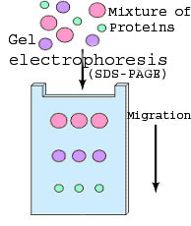
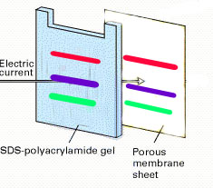
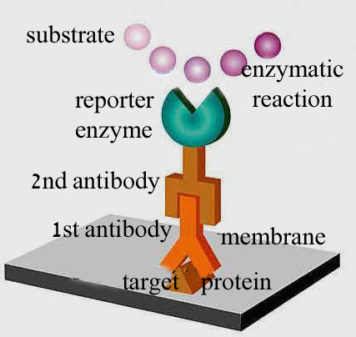
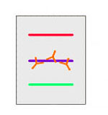
Analysis of protein levels: Western blot
1
3
2
4

Slide 38
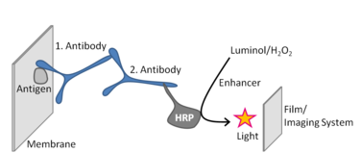
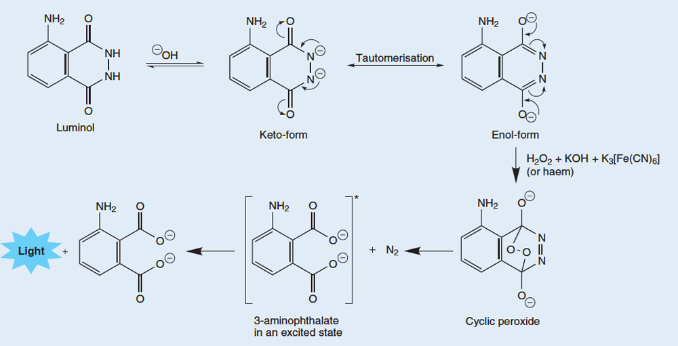
Types of Antibodies used for visualization
1.
HRP-Antibody
Chemiluminescence
Mechanism:

Slide 39
Types of Antibodies used for visualization
Other substrates that can generate light for detection

Slide 40
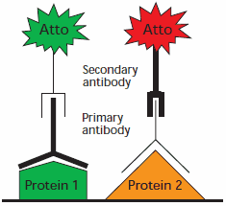
Types of Antibodies used for visualization
2.
Atto dyes are a family of commercially available dyes with enhanced photophysical properties (e.g., high photostability)

Slide 41
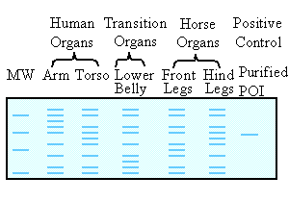
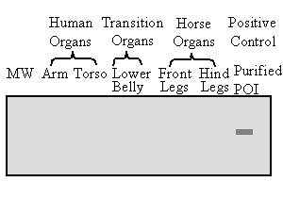
Analysis of protein levels: Western blot
Comparing two common procedures
for protein detection:
Coomassie staining (detects all proteins)
Immunoblot (Western blot)
(detects only the POI)

